Slide 1
Cost of Living Crisis Prevention Advice Project (CoLCPA)
Event at Redbridge Library, March 14th

Slide 2
CoLPCA – An Introduction
CoLCPA is a strategic partnership collaboration funded by GLA to support London Legal Support Trust (LLST) and London Citizens Advice (LCA) to increase the capacity of advice agencies to respond to the cost-of-living crisis and support more Londoners. The project funds 40 advice and community agencies across London and community training called ‘Advice First Aid’.
The partnership aligns with and supports the GLA’s mission to build a “Robust Safety Net”

Slide 3
CoLPCA – Partners
London Citizens Advice
London Legal Support Trust Centres of Excellence Network
Network of 28 local Citizens Advice charities working in all London boroughs, providing a range of information and advice
Network of specialist legal advice agencies in London and South-East (40 are London organisations)

Slide 4
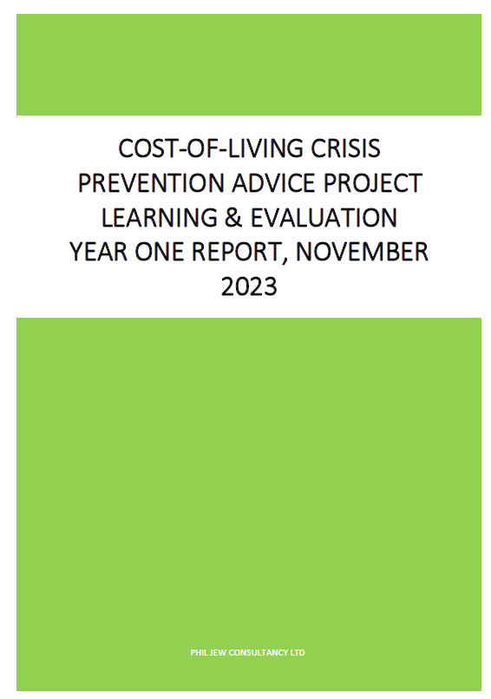
CoLPCA – Capacity
LCA 20 delivery partners based in higher areas of deprivation: Deployed 23 full-time equivalent staff - 16 FTE generalist/crisis prevention advisers (some split over part time roles), 5 specialist welfare advisers, 1 communities referrals adviser, an ‘Advice First Aid’ training lead and a project manager.
LLST 20 delivery partners – 16 CoEx, 1 other Law Centre and 3 community organisations: Deployed 41 roles split across 14 generalist roles (including 4 apprentice roles) and 27 specialist legal advice roles (equivalent to 21 FTE across)
Joint learning partner/evaluation consultant

Slide 5
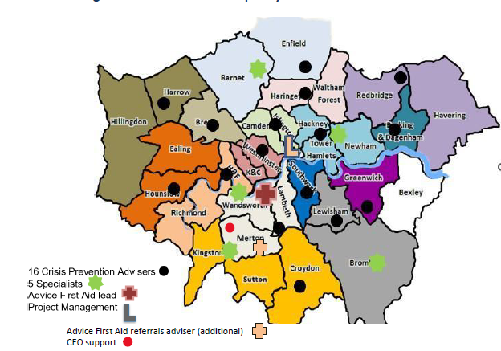
CoLPCA – Geography LCA

Slide 6
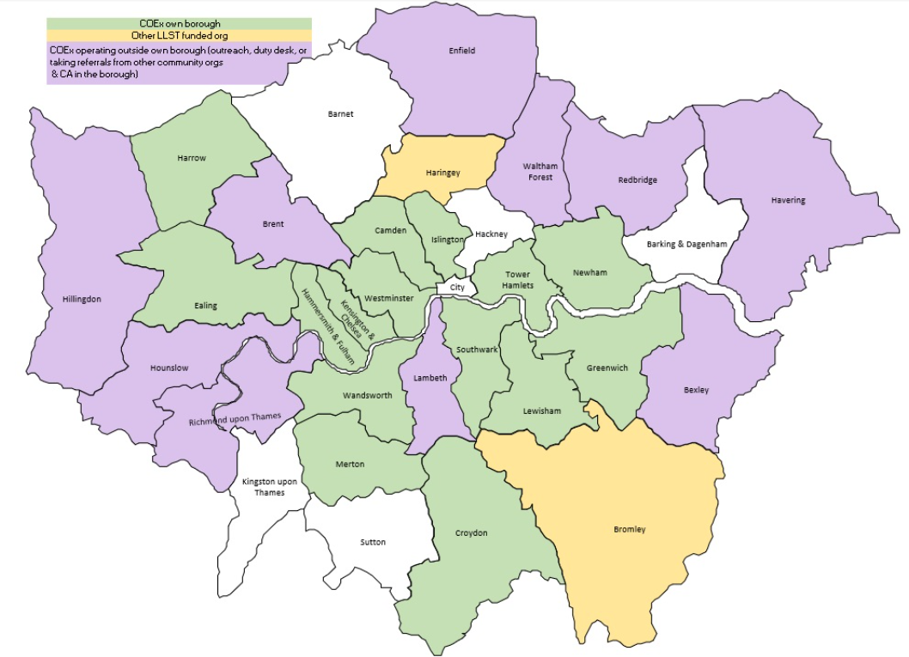
CoLPCA – Geography CoEx

Slide 7
CoLPCA – Londoners reached
Year 1 – Full year
Year 2 – Quarter 1
London CA |  | LLST - CoEx
Generalist / Crisis prevention & navigation | Specialist | Generalist / Crisis navigation | Specialist
8,352 | 1,285 | 6,467 | 3,357
4,715 Londoners attended CoL events 508 attended from 90 organisations & community groups attended 39 AFA sessions
CLIENT FINANCIAL GAINS = £9,487,970
London CA |  |  | LLST - CoEx
Generalist / Crisis prevention & navigation | Specialist | Specialist | Generalist / Crisis navigation | Specialist
5,221 | 405 | 405 | 1,711 | 686
4,171 Londoners attended CoL events 344 attended from 92 organisations & community groups attended 22 AFA sessions
CLIENT FINANCIAL GAINS = £3,521,224

Slide 8
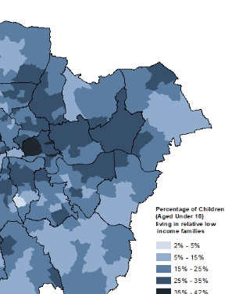
CoLPCA – North-East London
North-East London is a growing area of advice and legal needs, but advice agencies are underfunded and under-supplied compared to other parts of London.
Barking and Dagenham – worst indices for child poverty, deprivation, skills, mortality
Redbridge Temporary accommodation – no of households in TA per 1,000 = 24.96; London average 15.99
Havering Council – on the brink, but surging demand in social care, and children’s & youth services
Deprivation/inequalities cluster – Waltham Forest, Haringey, Enfield borders
Londoners incomes in NW London boroughs under a third of mean incomes wealthy inner London boroughs
CoLPCA partners
CA Redbridge/Havering partnership, CABD
University House outreach

Slide 9
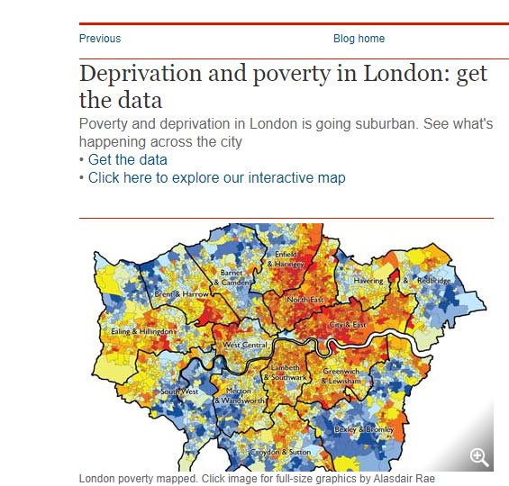
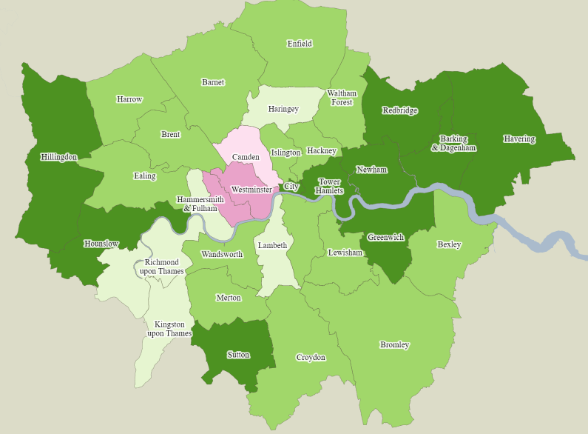
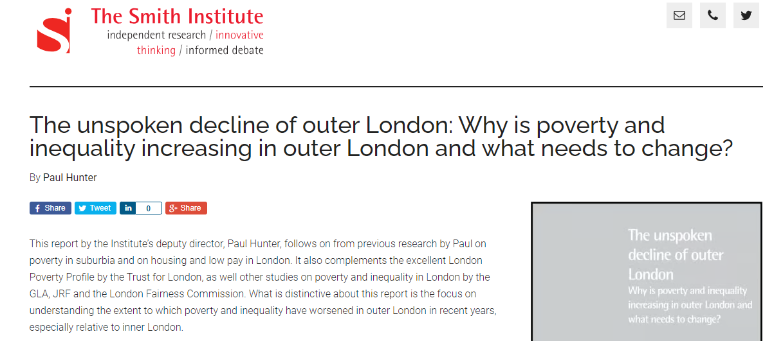
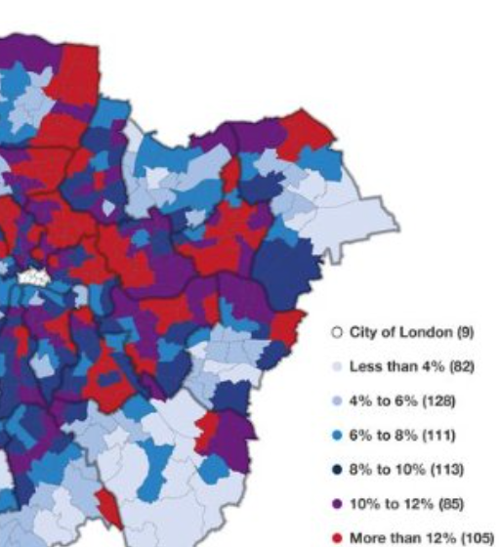
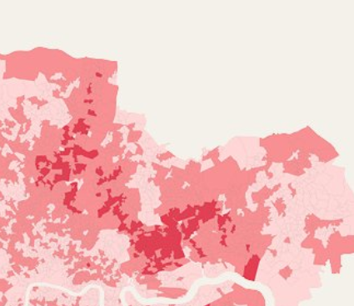
CoLPCA – North-East London
Population increases in London
Proportion of working age population claiming an out of work benefits
Concentrations of fuel poverty over 20%

Slide 10
CoLPCA – Londoners in crisis: Policy issues
Key issues emerging from the project
General trend for clients presenting with more crisis issues and multiple issues, increased complexity and problems becoming harder to resolve
Housing – Londoners struggling with housing costs, boroughs ‘gatekeeping’ housing options, rise in threatened homelessness, disrepair issues, and problems with out of borough temporary accommodation placements.
For advice and legal support organisations in London there are significant capacity and workforce development challenges – so a need for an overall cross sectoral Pan-London strategy to address these issues (See, Advising Londoners & Mind the Gap reports)

