Slide 1
Citizens Advice
London
Addressing Health Inequalities in the Capital
Advice delivered in the health & social care sector to improve patient outcomes

Slide 2
At Citizens Advice we are constantly thinking about areas where we can turn the dial for society, making a real difference to people’s lives.
Health is one of those areas. The issues that we advise people on - debt and welfare, housing and discrimination - are widely recognised as the determinants of health. By acting early and helping people to find their way forward, we not only improve health outcomes but also ease the burden on health services; enhancing the quality of life and saving public money.
We’ve gathered together examples of the work we are doing in primary and secondary care, in community settings, in social care and at the level of population health. Working in partnership with the NHS, other charities and across sectors, we bring our trademark approach of focusing on the whole person.
We can do this in part because Citizens Advice is an anchor institution in towns and cities across the country, enriching the social fabric of local communities. Through the delivery of our services we gain rich and valuable insights into those communities and the people who come to us for help, who are often on the verge of accessing other services.
With the renewed focus on levelling up, and the formation of Integrated Care Systems there is an opportunity to amplify this impact; helping more people and ensuring that we move from being a hidden health service to part of a truly integrated health offer nationally, and in local communities.
Dame Clare Moriarty DCB, Chief Executive, Citizens Advice

Slide 3
Our impact for Londoners’ health
Our reach into disadvantaged groups
Our clients are disproportionately affected by disability and health inequality; low income and poor living conditions affecting their health and wellbeing.
Our clients told us that before coming to Citizens Advice…
62%
They struggled to get on with day to day life
78%
Their problems made them feel stressed or anxious
8 in 10 clients do not meet the minimum income standard
36%
Their problems caused an unstable housing situation
Over a third are disabled or have a long term health condition
In 2022 – 2023, we helped…
Over 150,000 Londoners,
Via face to face appointments, telephone email or webchat
This achieved £117,359,402 financial outcomes for Londoners (income gains, re-imbursements, debts written off, repayments scheduled etc)
Mental health is the number 1 health issue for our clients
After advice, our clients said…
80%
Their problem was resolved
80% of those said they couldn’t have solved it without us
60%
It was easier to get on with their day to day lives
71%
They felt more confident to resolve similar problems in future
53%
We helped improve at least one aspect of their lives

Slide 4
Tackling health inequalities - the role of advice
..Patients who are seen in clinical settings may well have problems in their everyday lives that may be causing or exacerbating their mental and physical ill health or may be getting in the way of their recovery. If we do not tackle these everyday “practical health” issues then we are fighting the clinical fight with one hand tied behind our back.’ Sir Michael Marmot, Director of the UCL Institute of Health Equity
The Citizens Advice service is made up of
the national charity, and our network of 259 independent local Citizens Advice charities operating from 1500 advice giving locations across England and Wales
Across London there are 28 local Citizens Advice charities
We have multiple ways people can contact us; whether it's in person or over the phone, our high quality advice is accessible for all which means local Citizens Advice services are well placed to support in tackling health inequalities as set out in the NHS’s Core20PLUS5 approach
To get the best health outcomes, people need access to personalised health and social care as well as good quality support. Having access to quality care and support will give people the skills and knowledge needed to tackle the wider issues and stresses in everyday life which exacerbate health inequalities, and turn a non-clinical issue into a clinical ones.
Despite the upheavals that Covid-19 and the cost-of-living crisis have brought to all of our lives, Citizens Advice continues to provide the right advice in the right place at the right time to Londoners. We do this through a targeted person-centred approach to address the socio- economic issues that are barriers to improving people’s health and wellbeing outcomes.
Citizens Advice are experienced in offering advice in clinical settings. Clients tell us about the positive impact our advice has on their health and feedback, from practitioners lets us know how valuable our advice interventions are when advice is integrated into health and social care services.
Over 60% of clients have told us that they felt less stressed, depressed or anxious as a result of the help they received
Over 40% felt their physical health had improved
The benefits of our advice are not just limited to patients. Health professionals reported a:
significant reduction in time spent discussing non-clinical issues
reduction in frequency of visits
cost saving to the NHS
Our advice achieves
£ 322,502,200
in social and economic value to society

Slide 5
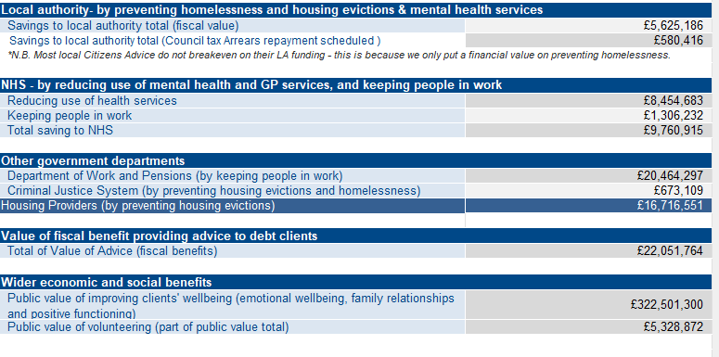
Tackling health inequalities - the role of advice
Detailed Breakdown
The Citizens Advice service is made up of
the national charity, and our network of 259 independent local Citizens Advice charities operating from 1500 advice giving locations across England and Wales
Across London there are 28 local Citizens Advice charities
We have multiple ways people can contact us; whether it's in person or over the phone, our high quality advice is accessible for all which means local Citizens Advice services are well placed to support in tackling health inequalities as set out in the NHS’s Core20PLUS5 approach
Over 40% felt their physical health had improved
The benefits of our advice are not just limited to patients. Health professionals reported a:
significant reduction in time spent discussing non-clinical issues
reduction in frequency of visits
cost saving to the NHS
Our advice achieves
£ 322,502,200
in social and economic value to society

Slide 6
Achievements by Local Citizens Advice
Health settings in Camden
*Felix’s story
Felix is in his 50’s and has poor mobility due to multiple health problems. He lived at his sister’s property where he cared for her until she passed away.
Felix had visited his GP who referred him to *Kate, a Citizens Advice caseworker at the surgery.
Felix was worried about how he would cover the costs of the funeral and his housing situation as the tenancy could not be transferred from his sister.
Kate was able to support Felix to:
negotiate with the Housing Association and ensure Felix could stay in the house until a permanent alternative property could be found.
apply for bereavement benefits to cover the funeral expenses.
Following advice….
Felix was happy to be rehoused in an adapted bungalow, appropriate to his mobility needs. Felix felt his new housing situation had started to improve his health
*Names have been changed to protect anonymity
Citizens Advice Camden deliver advice in several health settings across the borough – including a full-time advice service for families of children at Great Ormond Street Children’s Hospital. The service began in 2008 in response to the unmet needs of sick and disabled children and their families arising from poverty and deprivations; a need which the pandemic and now the cost-of-living crisis has increased. We provide high quality information, advice and in-depth casework support for families of children who are patients at GOSH. We also provide an ‘open door’ service to our GOSH partners such as social workers and family support officers in areas of our expertise.
Advice, information and casework services for patients and their families/ carers at
Royal Free Hospital Oncology Department and Renal service
Kentish Town Health Centre for patients of the James Wigg & Queen’s Crescent GP practices.
CHIP, Camden Health Improvement Practice
Find out more about this project by visiting Citizens Advice Camden website
client debt written off
income gained for clients through successful benefits claims
possession proceedings were successfully suspended, keeping vulnerable people in their homes

Slide 7
Achievements by Local Citizens Advice
Mental health and practical problems
Back on Track in Southwark
The Back on Track project was set up after clear links between physical, mental and financial health had been evidenced in a report published by Impact on Urban Health. The project provides advice and support to working age people in Southwark and Lambeth who have one or more long term health conditions and are worried about their finances.
Citizens Advice Southwark and Age UK Lambeth delivers the project in Lambeth, working closely with social prescribing link workers employed by the Primary Care Network. The partnership means support with a variety of advice issues can be given as well as ensuring health needs are also met. Referrals can come from Social Prescribing Link Workers; GP practices; community organisations; and creditors participating in the project.
Resolving practical issues can play an
important part in supporting people with mental health problems to build resilience and improve outcomes.
Last year in England Citizens Advice helped people with mental health problems solve over half a million issues. Many of these clients were at crisis point, and needed urgent advice on complex issues.
Our evidence shows:
Over 70% of clients have low confidence in resolving their problem without an adviser’s help
70% of clients with mental health problems say they have low knowledge of their rights
The project has also set up a Joint Creditor Forum, which includes local councils, and housing associations. These creditors have agreed to work together to develop a new joint debt recovery protocol for social landlords and local authorities, which provides a 60 day local breathing space for residents engaged in the project during which other financial and ‘wrap around’ support can be provided.
For more information visit www.financial-shield.uk.
Client feedback
*Pete found it quite difficult to explain his issue due to anxiety, and got confused and stressed quite easily. Our adviser gave Pete the time, space and understanding he needed in order to help resolve his problem.
Thank you for taking that little more time for me. It wasn't just the advice you gave, but the sincerity of wanting to do everything you could to help, and the respect, patience and genuine concern.
Pete
*Names have been changed to protect anonymit

Slide 8
Achievements by Local Citizens Advice
Advice First Aid Training
Case study - The Elays Network
Citizens Advice Wandsworth (CAW) delivers Advice First Aid (AFA) to local statutory and voluntary service providers. The training is an opportunity to upskill volunteers and staff working on the frontline of any public facing local service (including health & care workers and volunteers) to support vulnerable people in the community. The project was developed in recognition of the fact that people in need of advice too often don’t come to advice centres, and that supply of advice services will always be outstripped by demand. With the support of the GLA the training is being extended across London. The purpose is to:
The Elays Network is a Somali led organisation in Battersea, London. They work with a variety of ages and backgrounds within the community, providing a network of intergenerational support.
Elays staff have been trained by CAW as Advice First Aiders which has:
built trust between the two organisations
given Elay staff the confidence to provide quality information and signposting to the families that use their services.
Elays staff provide interpreting services to CAW which has generated income for Elays.
Use the white space to write about your own Advice First Aid Training experience or remove this slide if it is not relevant.
Use the Pink area for a testimonial
Use the Teal area for quotes.
Remove this guidance before distribution.
Increase the ability of voluntary, community and faith groups to spot advice issues,
Equip these groups with key advice facts and concepts, basic advice principles (e.g. confidentiality), and knowledge of advice resources; thereby enabling them to provide effective advice, information and signposting.
Build trust in advice services – leading to the development of effective and trusted referral relationships across the local area.
AFA has been delivered to over xxx individuals from multiple voluntary, community and faith organisations in Wandsworth and other boroughs, In addition, CAW have trained Local Councillors, social prescribing link workers, and Local Authority Housing team.
Excellent course. Lots of detail explained in a manner I could understand - Elays Attendee
Extremely helpful session, and very useful handouts. I’ll be able to use this information to help the people who come to us for support - Elays Attendee
The AFA training model challenges previous notions of what it means to deliver advice to people in need and has resulted in advice skills been identified by participants as a useful, and in some cases an essential, ability to have.
[Robin Brady, Evaluation Consultant, 2019]

Slide 9
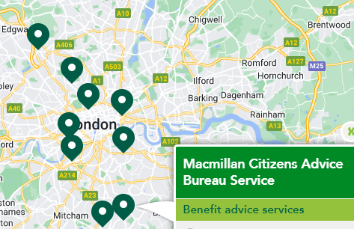
Achievements by Local Citizens Advice
Macmillan Partnerships
Macmillan Partnerships are health-led collaborations. Citizens Advice and Macmillan Cancer Support are working together to provide welfare benefits advice to people affected by cancer.
Several local Citizens Advice work in London with MacMillan Cancer Support to deliver welfare benefits to those affected by cancer.
The service reduces the stress experienced by patients by maximising income and dealing with other issues associated with the cost of coping with cancer. Our advisers seek to improve the finances of individuals living with cancer, together with their immediate family and carers, and offer a level of support appropriate to their needs. Advice is mainly provided in places that are convenient to the clients including in their own home, in hospitals and other health settings.
Evidence indicates that benefits related financial support and advice delivered in healthcare settings leads to worthwhile financial benefits for recipients. The additional resources gained through such services can improve an individual’s ability to cope with health problems and enables them to afford necessities and additional items required as a result of a diagnosis of cancer.
Macmillan and Citizens Advice: ‘Working together to help with the cost of cancer’
Often patients are not aware of the financial help they are entitled to, and many benefits go unclaimed including disability benefits and carers’ support.
Hospitals and NHS trusts we are currently working with to deliver services include
Barnet Hospital, North Middlesex Hospital, Finchley Memorial Hospital, Royal Free Hospital
King's College Hospital, Princess Royal University Hospital, Guy's and St Thomas' Hospitals, University Hospital Lewisham, and Queen Elizabeth Hospital
Croydon University Hospital, Epsom and St Helier Trust, Royal Marsden
Benefits of collaborating to deliver integrated advice within health services:
Cost savings - helps patients to overcome issues especially ones which cause delayed discharge
Building patient resilience - patient’s physical and mental health improves by dealing with all the presenting issues early
Collaboration - encourages good communication between the various teams
Improves knowledge sharing: - between clinicians and advice workers. Clinicians become better at spotting social welfare need.

Slide 10
Achievements by Local Citizens Advice
Advice on Prescription
Case study – Waltham Forest
Linking closely with Social Prescribing many local Citizens Advice in London have been able to deliver advice in primary and community health settings (e.g., GP surgeries) enabling clients to received a holistic service, where their broader wellbeing needs are addressed, not just their financial or health difficulties. There is no single model for how Citizens Advice work with local healthcare providers and primary care networks – so may include offering outreach appointments in primary care settings, to running referral project with local GPs and link-workers.
To improve access to high-quality benefits advice for vulnerable people, Citizens Advice Waltham Forest established an outreach benefit and debt advice service in three GP hubs with a good geographical spread across the borough. Referrals were made by GPs via a Social Prescribing Pilot project, which was established at around the same time as this project.
As the caseload increased over the life of the project, and the number of appeals escalated with the service accepting around six new clients per week, with three appointments reserved for follow-up appointments. All appointments are pre-booked and one hour long, which helps to reduce anxiety for patients with mental health problems who find waiting at drop-in services stressful. This model offering full advice support helps people who are more likely to disengage if just signposted or offered self-help.
The purpose is to provide wraparound support, and common outcomes include
Clients improved confidence at handling their economic circumstances to help to move from survival mode to coping and thriving
Reduced stress, and reducing time spent by healthcare staff on non-clinical issues
Improved economic circumstances for vulnerable service users
Improved access to benefits, debt and legal support and advice before they hit crisis point
Improved mental health and wellbeing as a result of receiving a holistic service, that evolves at their pace and is supportive and encouraging.
‘’Thank you for all the support you have given me throughout my PIP appeal. Your advice and encouragement were invaluable to me and there was so many times I wanted to give up. I was so tired of it all and without you I probably would have. You always phoned when you said you would and never let me down which from my experience is quite rare’’
Client feedback

Slide 11
How Citizens Advice give people the knowledge and confidence to find a way forward
This is *Anne.
Anne has a consultation to discuss her respiratory condition, which has been getting worse in recent cold weather.
1
While discussing her health problem with her GP, Anne mentions she’s been using the heating less as it’s so expensive to run. She seems anxious and stressed about her financial situation.
Advice sessions are held within the GP surgery at regular times each week.
2
The GP recommends Anne makes an appointment with the Citizens Advice in the surgery.
Health professionals identify that a patient has a ‘non-clinical’ issue and refer then to the advice service held within the GP surgery.
5
Ben finds Anne is not claiming all of her benefit entitlements, so helps her complete the paperwork to correct this.
Often clients needs support with more than the presenting issue. Advisers are able to unpick the underlying issues and work with the client to resolve them.
4
Anne discusses her situation with the adviser, *Ben. They discuss ways to reduce spending on energy bills and maximise Anne’s income.
Advisers have specialist training to support people with a whole range of practical issues which could be a barrier to better health.
3
Anne speaks with the receptionist to arrange this.
Patients can also ‘self-refer’ by booking advice appointments through the surgery.
Following advice…
Anne is less stressed and focussing on her health feels more manageable.
She has some additional income and reduced her energy bills, meaning she can use the heating more often and keep her home warmer.
She is keeping up with her treatment and her respiratory condition is improving, meaning fewer GP appointments.
*Names have been changed to protect anonymity
6
Ben also helps Anne compare energy tariffs to look for the best deal, and checks if she is eligible for additional discounts from her energy supplier because of her condition.
Advisers also connect people to other specialist services offered by Citizens Advice i.e specialist debt advice.

Slide 12
The role of advice in population health management
Using our data as part of population health management allows:
a better understanding of need and local, regional and national trends - sharing data across a whole system can provide a more robust understanding of need and help all services, including the NHS respond in a more timely and effective manner
more effective planning - the number of people attending NHS services, and in what way, is influenced by people’s lives, personal choices, support frameworks and access to and use of other services
robust impact measurement - having one well-managed data capture system can be hugely beneficial, not just in facilitating a better understanding of an individual’s needs and progress, but also in being able to aggregate wider impact. This in turn facilitates planning.
Citizens Advice is a leader in sharing its data and analytics as we have:
a wealth of robust data which tells clients and whole population stories and can make a valid contribution in strategic planning, decision-making, service design, delivery and evaluation.
experience in combining our rich data with data from other organisations and have seen how this process delivers new insight and impact at a local and regional level.
We recommend only editing the highlighted area to give a local feel.
Remove this guidance before distribution.
improved inclusion for marginalised groups - these groups are often excluded from mainstream datasets and may also be reluctant to engage with routine data collection as a result of fear of, or experience of, stigmatisation or discrimination. As such, the needs of these populations are frequently overlooked in service planning and delivery.
Find out more by visiting our Tableau page
People who receive welfare advice experience lower anxiety, better general health, better relationships and housing stability. The right advice at the right time helps people manage their own lives, and promotes better physical and mental health.
The Role of Advice Services in Health Outcomes Evidence Review and Mapping Study, Advice Services Alliance, 2016.

Slide 13
Population health case study: sharing data between London Citizens Advice and London Councils
Overview London Councils and the Greater London Authority (GLA) Work with London Citizens Advice to gather data key cost of living and quality of life indicators, and to better understand the demographics of Citizens Advice service users in London.
Data sharing Data flows from London Citizens Advice and is integrated into the London Datastore which includes whole-system person level linked health and social care data-set. London Citizens Advice case-work data is pseudonymised in a compatible way and can be integrated with the other linked-data sources in primary and secondary care, mental and community health, adult social care and ambulance services.
Our anonymised data can provide intelligence to support the commissioning of health services. The data can be segmented sub-regionally so that health care provision can be planned to support the needs of the health populations across London’s Integrated Care Systems.
Why our data is so rich
We offer advice on a huge breadth of topics, from consumer issues to benefits, debt, housing, and much more
Issues
Our data is current, constantly being collected and updated.
3rd party data
Geography
We have 259 local Citizens Advice across England and Wales; 28 of which are based in London.
By providing raw data and combining it with other sources we can deliver new insight and greater impact
We’re here for everyone, and our network reflects the diversity of needs and circumstances
Demographics
Clients
Millions of people visit our website every year and view our advice content. Our web analytics shows fascinating trends in near real time
We see over 1 million people each year, and over 150,000 Londoners
Web trends

Slide 14
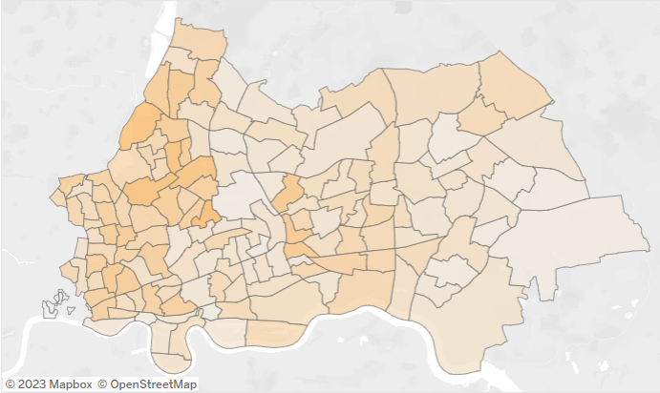
Population health case study: North East London ICS
Overview – City, Hackney, Tower Hamlets, Newham, Waltham Forest, Redbridge, Havering, Barking & Dagenham
Map shows pattern of client demand for support with the following health inequality indicators
Emergency crisis support – charitable grants, foodbank referrals
Fuel debts and energy issues
Personal Independence Payments
Housing costs support

Slide 15
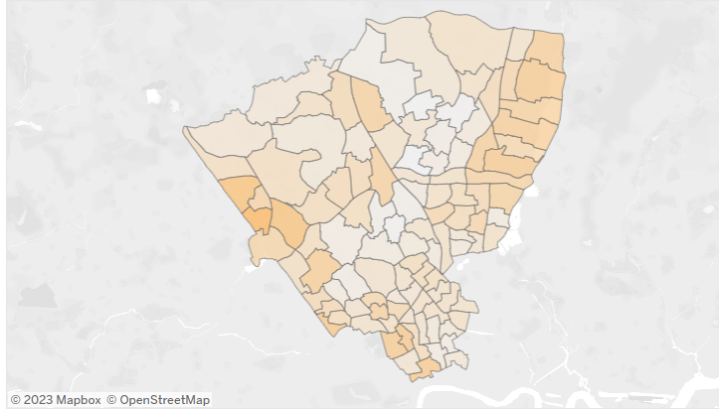
Population health case study: North Central London ICS
Overview – heatmap of health inequality indicators for Barnet, Camden, Enfield, Haringey, Islington
Map shows pattern of client demand for support with the following health inequality indicators
Emergency crisis support – charitable grants, foodbank referrals
Fuel debts and energy issues
Personal Independence Payments
Housing costs support

Slide 16
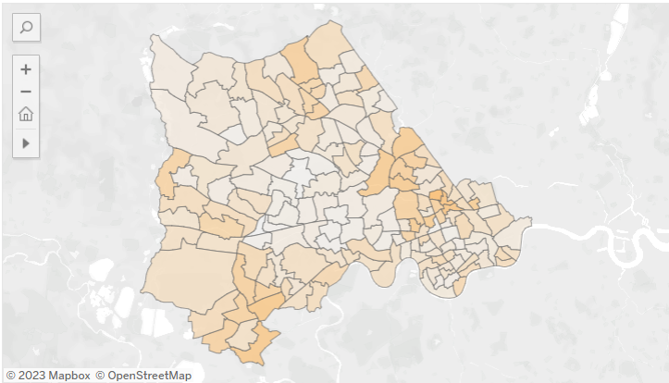
Population health case study: North West London ICS
Overview – heatmap of health inequality indicators for Brent, Harrow, Hillingdon, Hounslow, Ealing, Hammersmith & Fulham, Kensington & Chelsea and Westminster
Map shows pattern of client demand for support with the following health inequality indicators
Emergency crisis support – charitable grants, foodbank referrals
Fuel debts and energy issues
Personal Independence Payments
Housing costs support

Slide 17
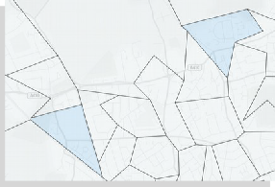
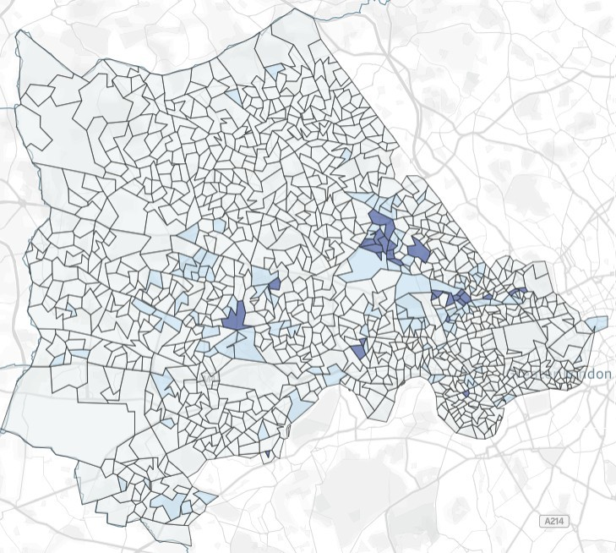
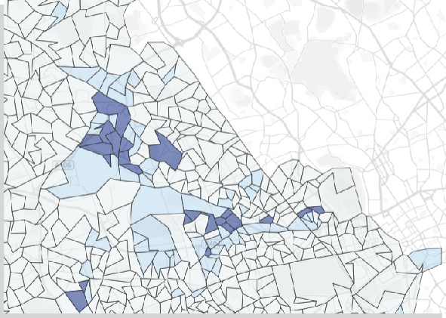
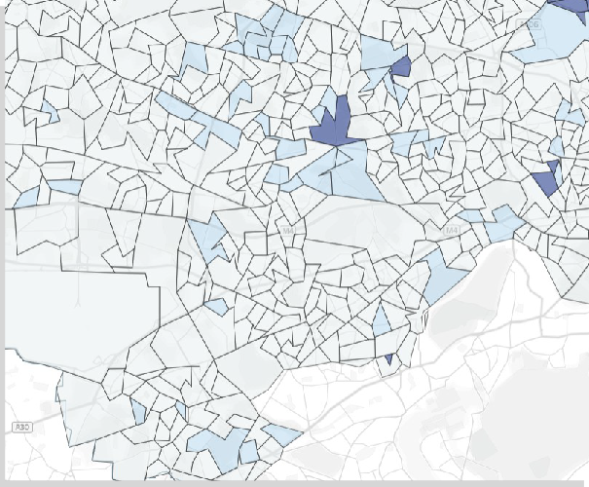
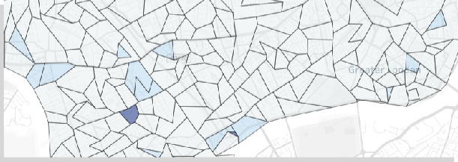
North West London IMD
STP/ICS map showing neighbourhoods (LSOAs) in 2019 Index of Multiple Deprivation deciles. Dark blue is for the most
deprived decile, light blue is for the second most deprived decile. Other deprivation deciles are left unshaded.
Interactive version can be viewed in tableau: https://tabanalytics.data.england.nhs.uk/#/site/viewpoint/views/PopDemo_CORE20/CORE20?:iid=1 (OKTA account required)

Slide 18
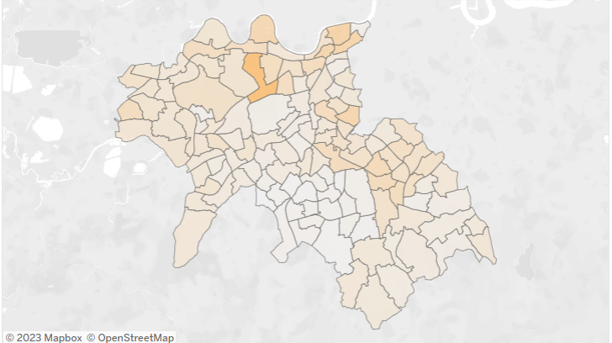
Population health case study: South West London ICS
Overview – heatmap of health inequality indicators for Croydon, Kingston, Merton, Richmond, Sutton, Wandsworth
Map shows pattern of client demand for support with the following health inequality indicators
Emergency crisis support – charitable grants, foodbank referrals
Fuel debts and energy issues
Personal Independence Payments
Housing costs support

Slide 19
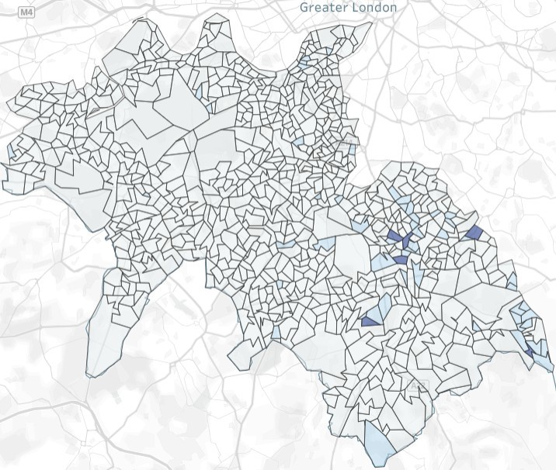
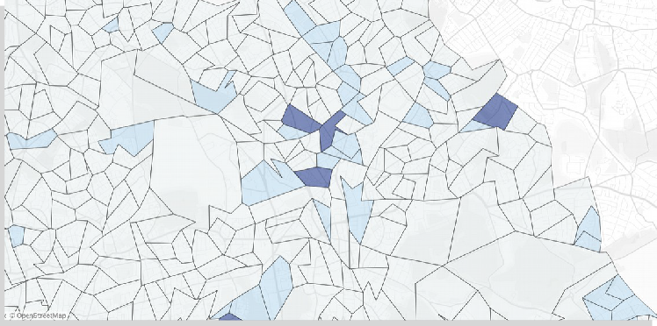
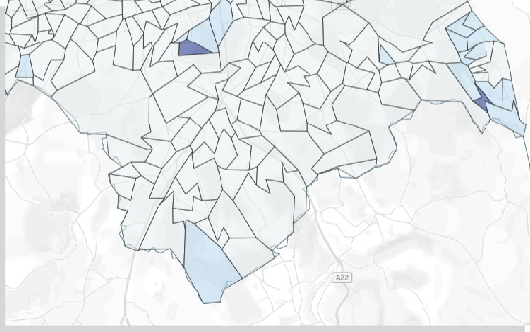
South West London IMD
STP/ICS map showing neighbourhoods (LSOAs) in 2019 Index of Multiple Deprivation deciles. Dark blue is for the most
deprived decile, light blue is for the second most deprived decile. Other deprivation deciles are left unshaded.
Interactive version can be viewed in tableau: https://tabanalytics.data.england.nhs.uk/#/site/viewpoint/views/PopDemo_CORE20/CORE20?:iid=1 (OKTA account required)

Slide 20
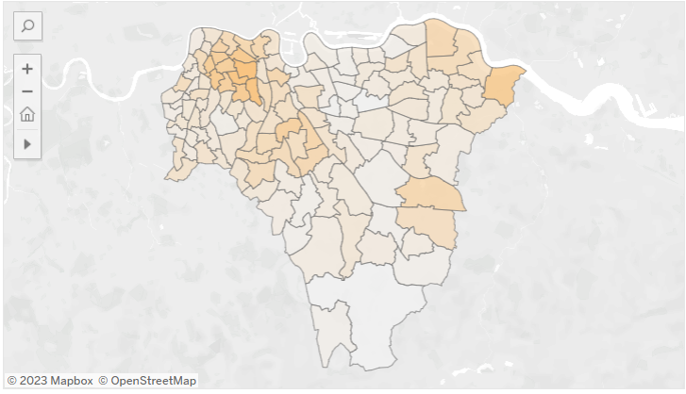
Population health case study: South East London ICS
Overview – heatmap of health inequality indicators for Lambeth, Southwark, Greenwich, Bromley, Bexley
Map shows pattern of client demand for support with the following health inequality indicators
Emergency crisis support – charitable grants, foodbank referrals
Fuel debts and energy issues
Personal Independence Payments
Housing costs support

Slide 21
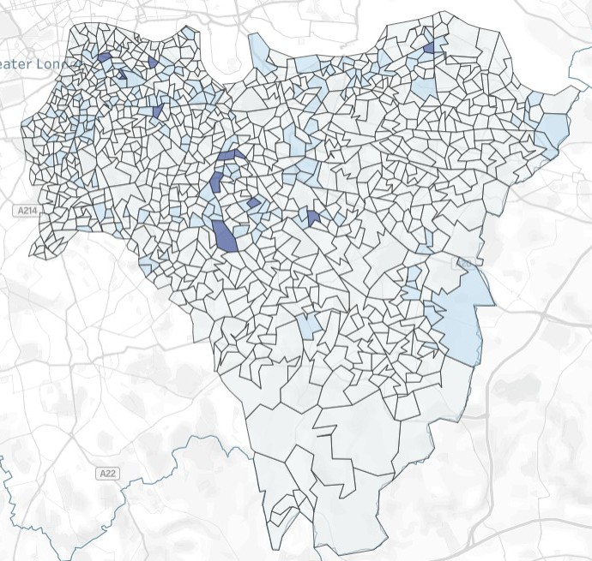
South East London
STP/ICS map showing neighbourhoods (LSOAs) in 2019 Index of Multiple Deprivation deciles. Dark blue is for the most
deprived decile, light blue is for the second most deprived decile. Other deprivation deciles are left unshaded.
Interactive version can be viewed in tableau: https://tabanalytics.data.england.nhs.uk/#/site/viewpoint/views/PopDemo_CORE20/CORE20?:iid=1 (OKTA account required)

Slide 22
How can London ICS work with Citizens Advice to improve wellbeing outcomes
Treat the whole person
Cold home, money worries, work stress and family breakdown and all exacerbate ill health. Advice can help people find a way forward.
1
Make it easier for public services and voluntary sectors to work closely by developing community hubs where teams can integrate, using existing community assets or developing new ones out of underused estates
2
Support partnerships between health, social care and voluntary sector providers to provide wraparound support to those who may be leaving hospital or at risk of needing long-term care.
5
Raise awareness of how issues for those with poor mental health cluster i.e a client needing support with debt is likely to need support with benefits, food poverty etc. Mental health service providers need to broaden their range of partners to address the wider socio- economic issues while also providing clinical support
4
Provide funding that actively supports partnership working across sectors. Any targets attached to the funding should be driven by outcomes for clients rather than numerical outputs. .
3
Ensure triage/referral pathways for social prescribing and advice are backed-up by service capacity. Patients could also ‘self-refer’ by booking advice appointments through the surgery, or access services on site
6
Invest in community-based provision that actively seeks to move those who are out of work towards the workplace. Increasing community-based volunteering opportunities, and employment support (e.g. CV writing or interview skills) alongside support for practical issues that may be a barrier to work, such as debts, housing problems, child care or benefits problems. .
Prescribing advice…
The UCL Review of Health Inequality Interventions recommended
Embed financial wellbeing and resilience into clinical pathways, considering how and where to co-locate services to support people
Engage and involve communities, VCSE sector and local leaders in assessment of current services and interventions and the development of new ones
Investment in voluntary and community services, in particular advice and support services, offers a high return on investment. Interventions should be developed collaboratively with affected communities in a way that empowers and gives a voice to people most impacted by falling incomes.

Slide 23
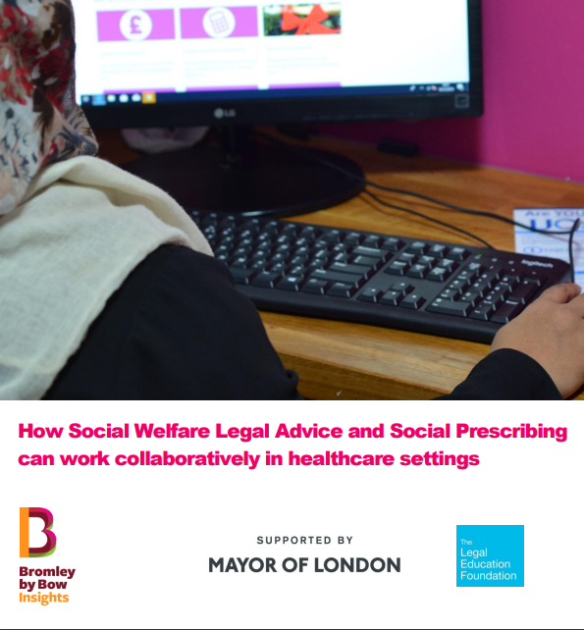
How Social Welfare Legal Advice and Social Prescribing can work collaboratively in healthcare settings (2021)
Report by Bromley by Bow, with support from Mayor of London and Legal Education Foundation
Over the past 15 years, social prescribing has steadily established itself as a crucial component of primary and social care settings, initially as very much a bottom-up, locally developed movement, and more recently being adopted as national policy and rolled out. This mainstreaming has been cemented by NHS England’s decision to fund link workers as part of its commitment to widening the range of skills and specialisms within each Primary Care Network (PCN), with a commitment to 1,000 in post by March 2021, rising to 5,500 over the following three years.
Whilst models of social prescribing schemes and its adoption within PCNs varies, the vast majority had at least one link worker in post by July 2020, and in August NHS England launched a scheme to incentivise the rapid recruitment of the next 500 link workers. However, alongside this, there is concern that this commitment to universal access to social prescribing as part of the NHS model, with funding for social prescribing schemes and link worker roles, but without consideration of the capacity of and connection with the crucial services that they refer into risks jeopardising the endeavour.
Social welfare legal advice is one of the most prominent amongst the types of services that social prescribing refers onto meaning that the interconnection between the two services is critical to the effective operation of social prescribing and the achievement of its intentions. Despite this, and although the issues it aims to resolve are often considered foundational within need hierarchies, social welfare legal advice has rarely been given central prominence in the discourse around social prescribing
There is emerging evidence that where social prescribing schemes and social welfare legal advice do coexist within healthcare settings (most often in primary care) there is ample potential for collaboration, increased efficiency and improved health and wider life outcomes for those accessing services. However, there is also a risk that without sustained efforts to connect these services up at both a strategic policy level and an operational one, they risk operating separately, having a mismatch in capacity levels and even competing for referrals meaning that this potential can go unfulfilled.

Slide 24
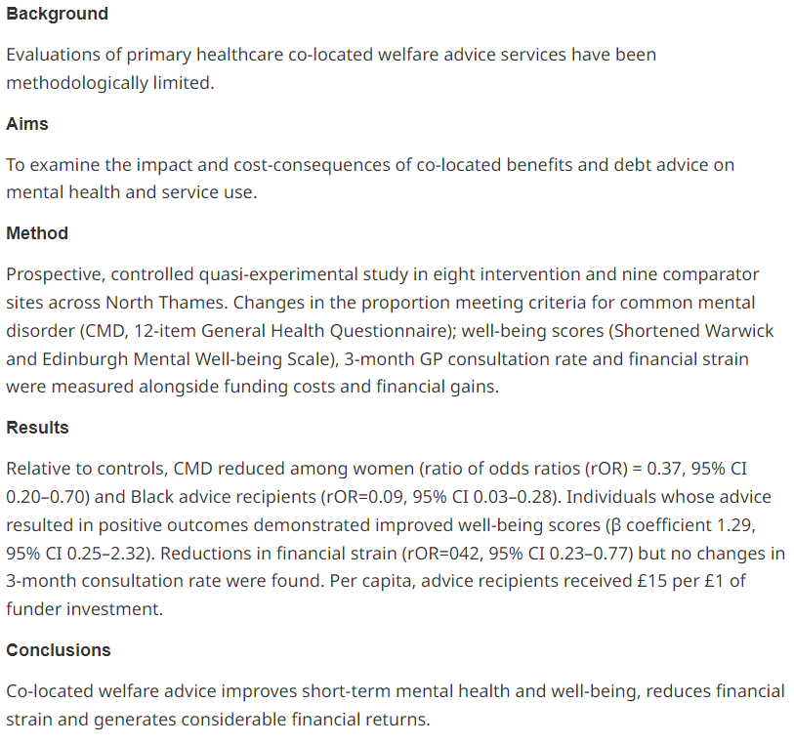
Impact of co-located welfare advice in healthcare settings: prospective quasi-experimental controlled study British Journal of Psychology (2018)
Report by Bromley by Bow, with support from Mayor of London and Legal Education Foundation
Over the past 15 years, social prescribing has steadily established itself as a crucial component of primary and social care settings, initially as very much a bottom-up, locally developed movement, and more recently being adopted as national policy and rolled out. This mainstreaming has been cemented by NHS England’s decision to fund link workers as part of its commitment to widening the range of skills and specialisms within each Primary Care Network (PCN), with a commitment to 1,000 in post by March 2021, rising to 5,500 over the following three years.
Whilst models of social prescribing schemes and its adoption within PCNs varies, the vast majority had at least one link worker in post by July 2020, and in August NHS England launched a scheme to incentivise the rapid recruitment of the next 500 link workers. However, alongside this, there is concern that this commitment to universal access to social prescribing as part of the NHS model, with funding for social prescribing schemes and link worker roles, but without consideration of the capacity of and connection with the crucial services that they refer into risks jeopardising the endeavour.

Slide 25
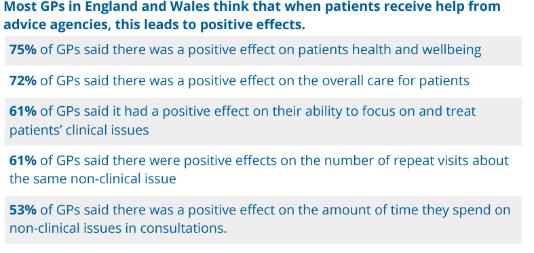
Advice in practice: Understanding the effects of integrating advice in primary care settings
Understanding the effects of integrating advice in primary care settings (2018)
Research in partnership with the Royal College of GPs (RCGP). We surveyed over 900 GPs across England and Wales — looking at the impact of advice in these settings

Slide 26
Citizens Advice helps people find a way forward.
We provide free, confidential and independent advice to help people overcome their problems. We are a voice for our clients and consumers on the issues that matter to them.
We value diversity, champion equality, and challenge discrimination and harassment.
We’re here for everyone.
For more information please contact
jsandbach@londoncitizenadvice.org.uk
© Citizens Advice April 2023

