Slide 1
Cost of Living Pro Bono Week launch event
November 2022

Slide 2
About Citizens Advice
We provide support in approximately 2,500 locations in England and Wales with over 18,000 volunteers and 8,650 staff. We help millions of people every year; in 2021-22 this included:
40.6 million visits to our website
183,000 people helped face to face (reduced f2f volumes since pandemic)
1.96 million people using our phone service
800,000 people getting help by email or webchat
87,000 witnesses supported through the Witness Service
Main Advice issues 2021-22:
benefits (724,000),
debt, money and financial capability (422,000),
housing (275,000),
employment (172,000),
consumer & energy (1.8m)
Notes:
People on low incomes are already twice as likely to be unable to afford their energy bills, with 1 in 12 unable to afford their bills even after cutting back on other essential spending (compared to 1 in 24 for people on higher incomes). From April, nearly half (47%) of people on low incomes predict they will have to fall behind on essential bills, or have to cut back on essential spending. This is compared to a quarter (25%) of people on higher incomes.

Slide 3
What are we seeing
As prices rise, people are making difficult decisions about what to cut back on and where they need to rely on community support.
The scale and size of the crisis is unlike even what we were seeing during the pandemic. We saw issues that might usually peak in winter, peaking in the middle of summer. Record numbers can’t afford to top up their prepayment energy meter (PPM); our research shows more than 450,000 people - the highest in nearly a decade - could be forced onto PPMs when they can’t pay their energy bills by the end of 2022.
We're helping 2 people every minute with crisis support, such as referrals to food banks and fuel vouchers. We’ve supported more people this year with crisis support than 2019 and 2020 combined, and worryingly, this trend continues to rise each month. This year we've also seen more people coming to us who are facing or experiencing homelessness than before the pandemic.
Notes:
People on low incomes are already twice as likely to be unable to afford their energy bills, with 1 in 12 unable to afford their bills even after cutting back on other essential spending (compared to 1 in 24 for people on higher incomes). From April, nearly half (47%) of people on low incomes predict they will have to fall behind on essential bills, or have to cut back on essential spending. This is compared to a quarter (25%) of people on higher incomes.

Slide 4
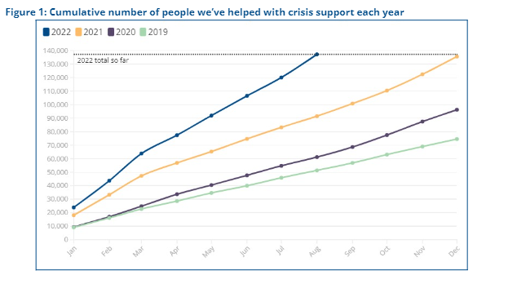
What are we seeing: Crisis support
Notes:
People on low incomes are already twice as likely to be unable to afford their energy bills, with 1 in 12 unable to afford their bills even after cutting back on other essential spending (compared to 1 in 24 for people on higher incomes). From April, nearly half (47%) of people on low incomes predict they will have to fall behind on essential bills, or have to cut back on essential spending. This is compared to a quarter (25%) of people on higher incomes.

Slide 5
Cost of living – London and national perspective
As the official watchdog for energy consumers and the country’s leading welfare advice organisation, we understand the impact of rising prices in London, England and Wales
latest estimates on energy prices from Cornwall Insight, figures will rise from 7m households now to 10.7m (a rise from 24.5% to 37.6% of households) in fuel poverty from April 2023.
UK food price inflation at annual rate of 11.6% (British Retail Consortium); one in four households with children (4 million children) have experienced food insecurity in the past three months month, an increase of 8% since April (Food Foundation)
2.5 million renters are either behind or constantly struggling to pay their rent, an increase by 45% since April 2022 (Shelter, Yougov)
Notes:
People on low incomes are already twice as likely to be unable to afford their energy bills, with 1 in 12 unable to afford their bills even after cutting back on other essential spending (compared to 1 in 24 for people on higher incomes). From April, nearly half (47%) of people on low incomes predict they will have to fall behind on essential bills, or have to cut back on essential spending. This is compared to a quarter (25%) of people on higher incomes.

Slide 6
Cost of living – London
28% of people live in poverty in London (2.5 million) compared to 22% in UK (Trust for London – London Poverty Profile)
Over one in nine households in London have low income and live in accommodation with low energy efficiency (GLA, London Datastore). In April 2022, the Ofgem electricity and gas price cap set by Ofgem was increased by 54 per cent, further increases to take average gas and electricity Bills to £70 per week. The £400 rebate will mitigate these amounts over the period October 2022 to April 2023 by only £15.38 per week. Even in London we’re looking at Number of households living in fuel poverty hitting 40% next year
ONS Opinions and Lifestyle Survey – 25 per cent of London sample reported their household could not afford an unexpected expense
Notes:
People on low incomes are already twice as likely to be unable to afford their energy bills, with 1 in 12 unable to afford their bills even after cutting back on other essential spending (compared to 1 in 24 for people on higher incomes). From April, nearly half (47%) of people on low incomes predict they will have to fall behind on essential bills, or have to cut back on essential spending. This is compared to a quarter (25%) of people on higher incomes.

Slide 7
Coping with the crisis – the poorest hit hardest
Based on analysis of a representative poll of 6,000 adults (18+) in the UK conducted by ICM Unlimited for Citizens Advice
20% of Londoners are currently unable to afford energy bills, even if they cut back/fall behind on other essentials; this jumped to 33% people after the energy price cap April, and only 8% thought that the energy rebate will help them
From April, nearly half (47%) of people on low incomes have been falling behind on essential bills, or have to cut back on essential spending. This is compared to a quarter (25%) of people on higher incomes.
By April 2023, low income households will have seen their monthly costs rise by over £200 compared to September 2021.
Notes:
People on low incomes are already twice as likely to be unable to afford their energy bills, with 1 in 12 unable to afford their bills even after cutting back on other essential spending (compared to 1 in 24 for people on higher incomes). From April, nearly half (47%) of people on low incomes predict they will have to fall behind on essential bills, or have to cut back on essential spending. This is compared to a quarter (25%) of people on higher incomes.

Slide 8
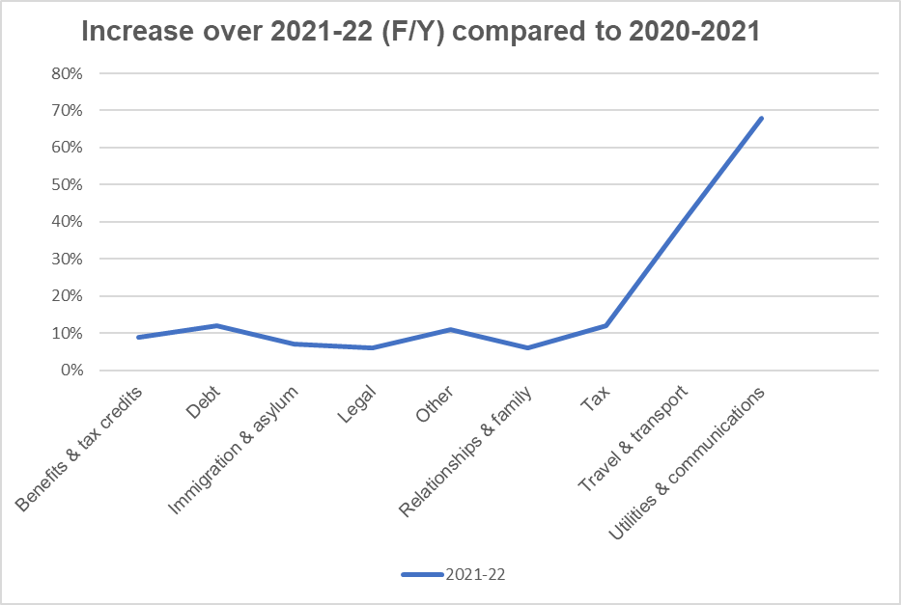
Increase demand on local Citizens Advice
We record advice inquiries on a national system – the areas of inquiry which saw the biggest increase were consumer issues relating to transport, utilities, fuel and other essential services

Slide 9
Some concerning trends….
Comparing London client stats 2020 and 2021:-
61% increase in number of clients looking to access localised welfare schemes, and a 46% increase in clients accessing charitable support
46% increase in Foodbank referrals/inquiries
43% increase in clients dealing with benefit deductions
Utilities and essential service
Fuel (gas, electricity, oil, coal etc.) | + 60%
Water (suppliers, debt etc) | + 36%
Transport (public, motor costs etc) | + 34%

Slide 10
Cost of living context/discussions
Big increase in debt clients, especially energy debts
Increase in Personal Indpendent Payments (PIP) inquiries
Increase demand on social housing and private rent inquiries, beginning to see threated homelessness issues increase to pre-pandemic levels
Increase in foodbank referrals especially single families and BAME clients
Trends tracked on CA Dashboard https://public.flourish.studio/story/1634399/

Slide 11
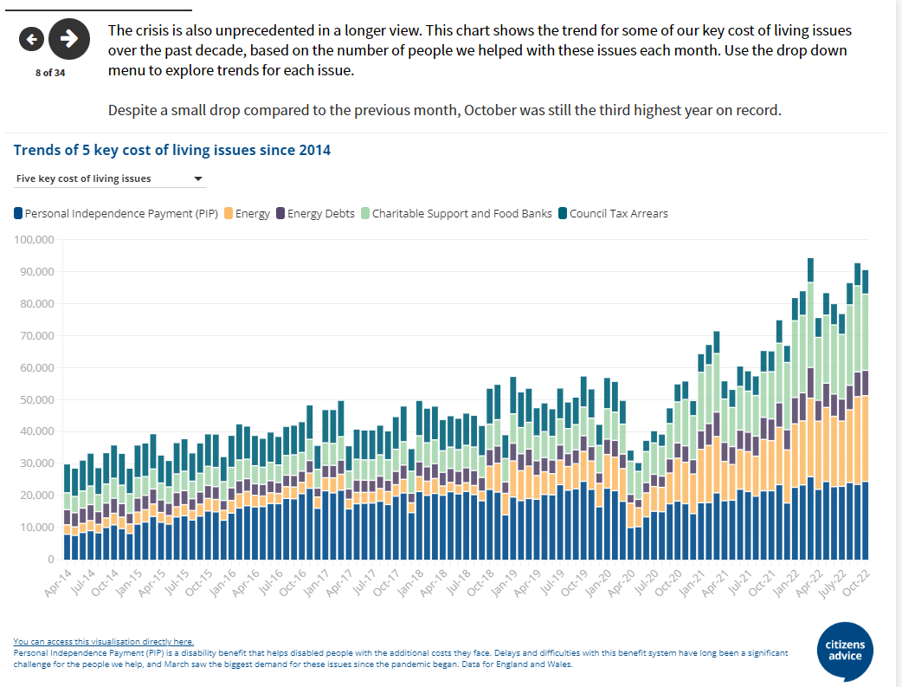
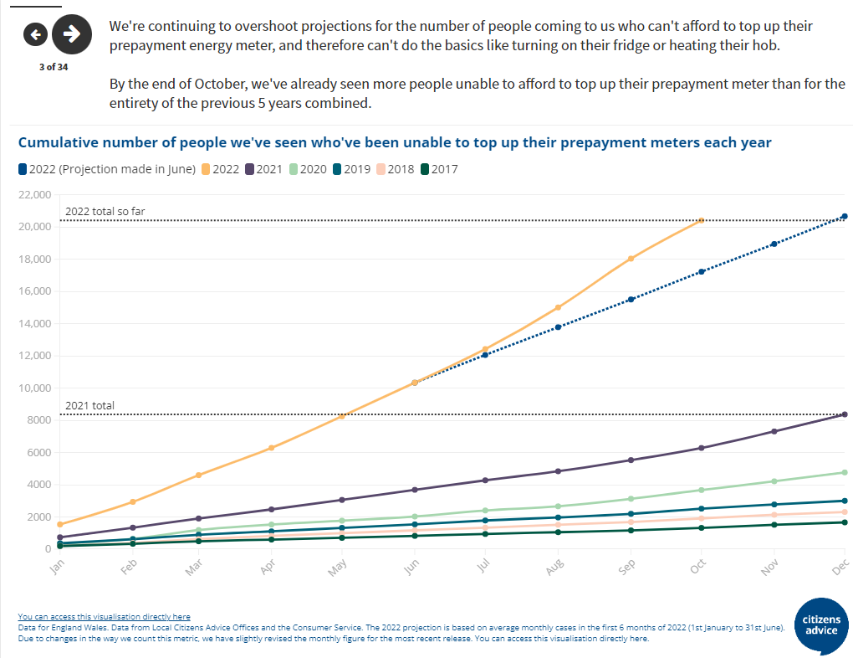
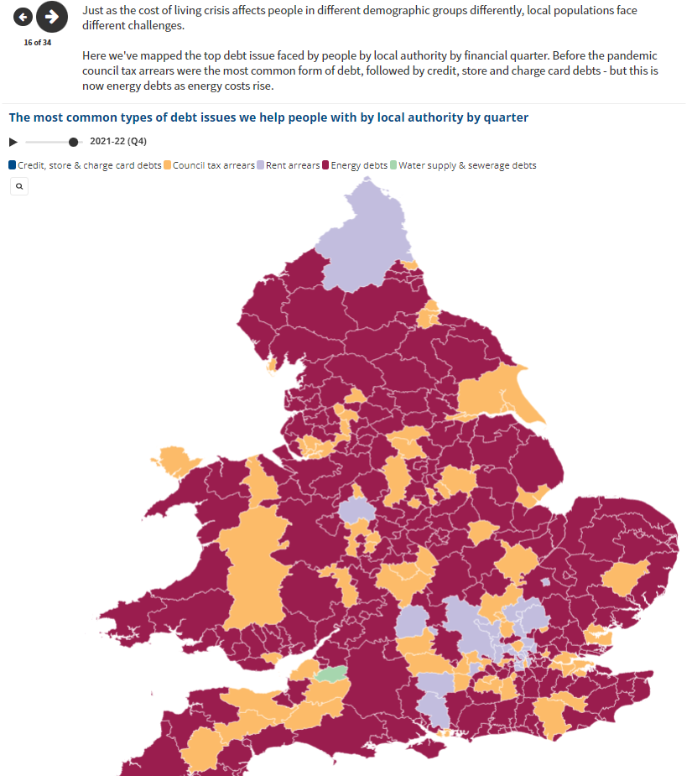
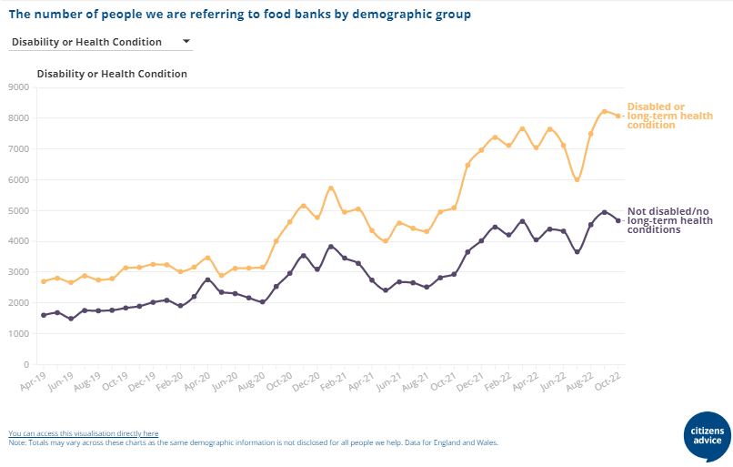
Dashboard
See https://public.flourish.studio/story/1634399/

Slide 12
Advice in London
28 local Citizens Advice
partnership between the GLA, London Citizens Advice, and London Legal Support Trust Centres of Excellence working with community groups/organisations aims to boost capacity and local support
https://londoncitizensadvice.org.uk/

Slide 13
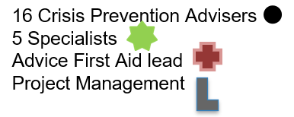
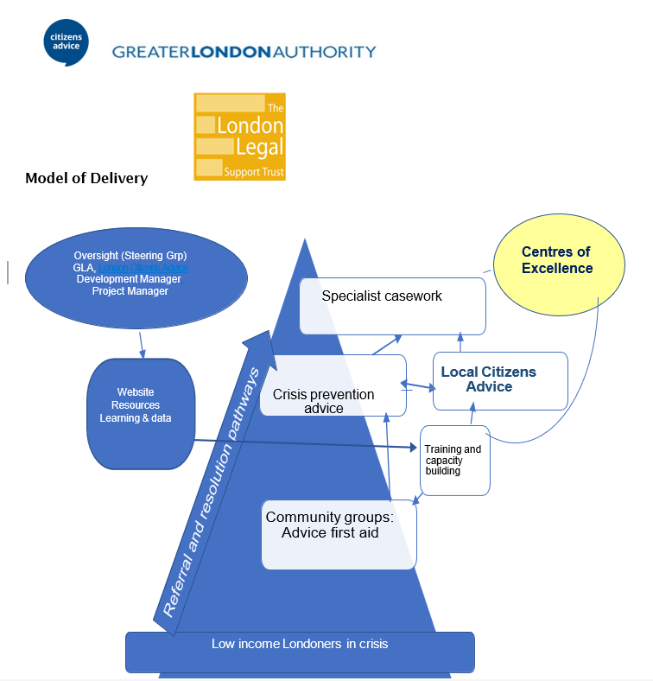
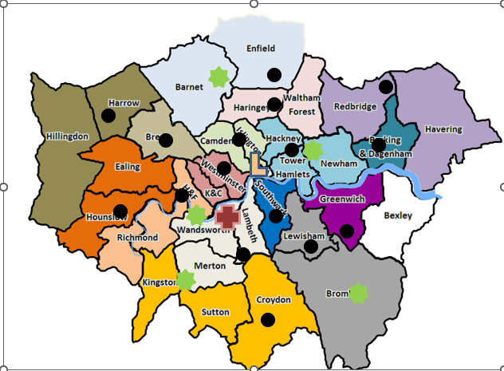
Partnering model
Need pro bono sector partners

