Slide 1

Havering & Redbridge
Population Profiles

Slide 2
Our Health
Our health is said to rest on 4 pillars. The top 2 pillars in terms of our health are the wider determinants & behavioral and lifestyle
July 2021 the COVID-19 impact inquiry, found
  poor health and existing inequalities had left parts of the UK more vulnerable to the virus and had influenced its devastating impact.
  pandemic has highlighted stark differences in the health of the working age population. Those below 65 in the poorest 10% of areas in England almost four times more likely to die from COVID than those in the richest.
  80% of our health, is not health service related

Slide 3

Population size
All 3 boroughs in outer northeast London have seen population growth.
Over the next 20 years, the population is forecast to grown by 120k.
Over half will be in Barking and Dagenham with the Thames Gateway development
Redbridge is forecast to grow by 11% (33k)

Slide 4
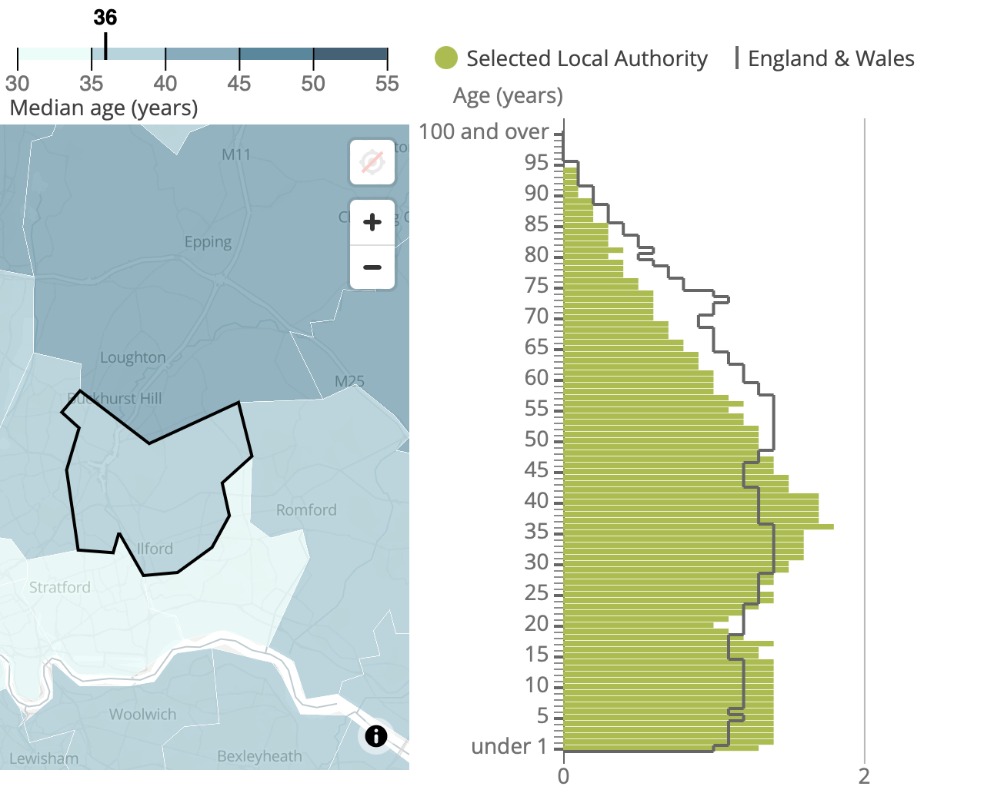
Redbridge Age Profile
Green columns 2021 Census returns vs national averages.
Younger population than national average
Slightly younger population than London profiles
Median age 36 years

Slide 5
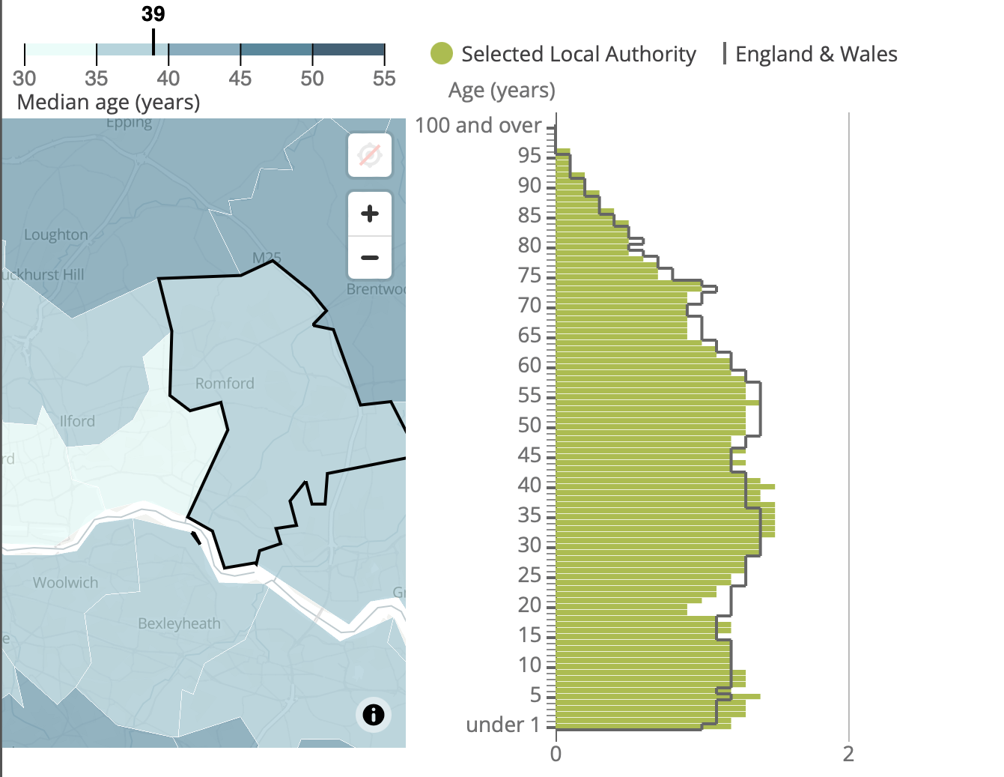
Havering Age Profile
Havering aligns with national averages in terms of age profile
23% of the population is aged above 60 (LBR 18%)

Slide 7
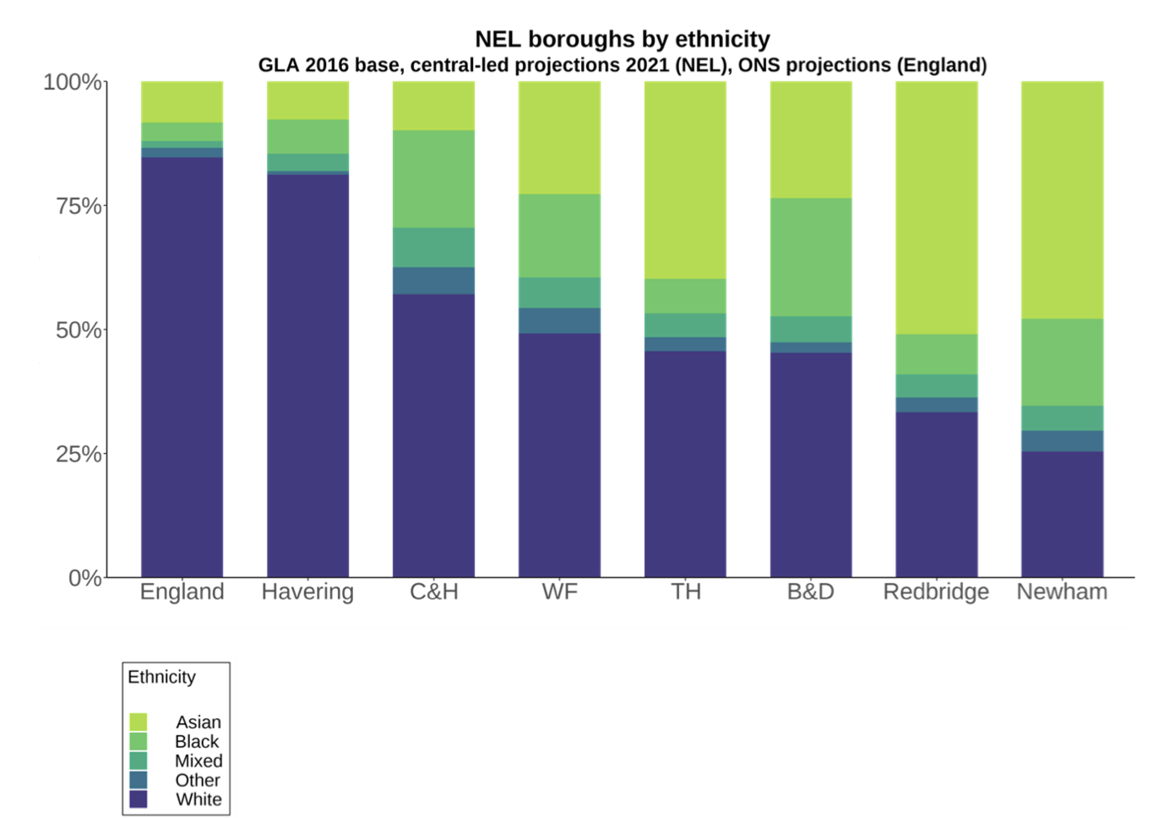
Ethnicity
London is the most ethnically diverse region of the UK
Ethnic diversity across London boroughs varies significantly.
Havering and Redbridge are very different to one another in terms of ethnic composition.
Redbridge second most diverse place in NEL, with 67% of its population being of Black, Asian, Mixed or Other ethnicity.
In contrast, in Havering 81% of its population is of White ethnicity with 8% identifying as Asian ethnicity.

Slide 8
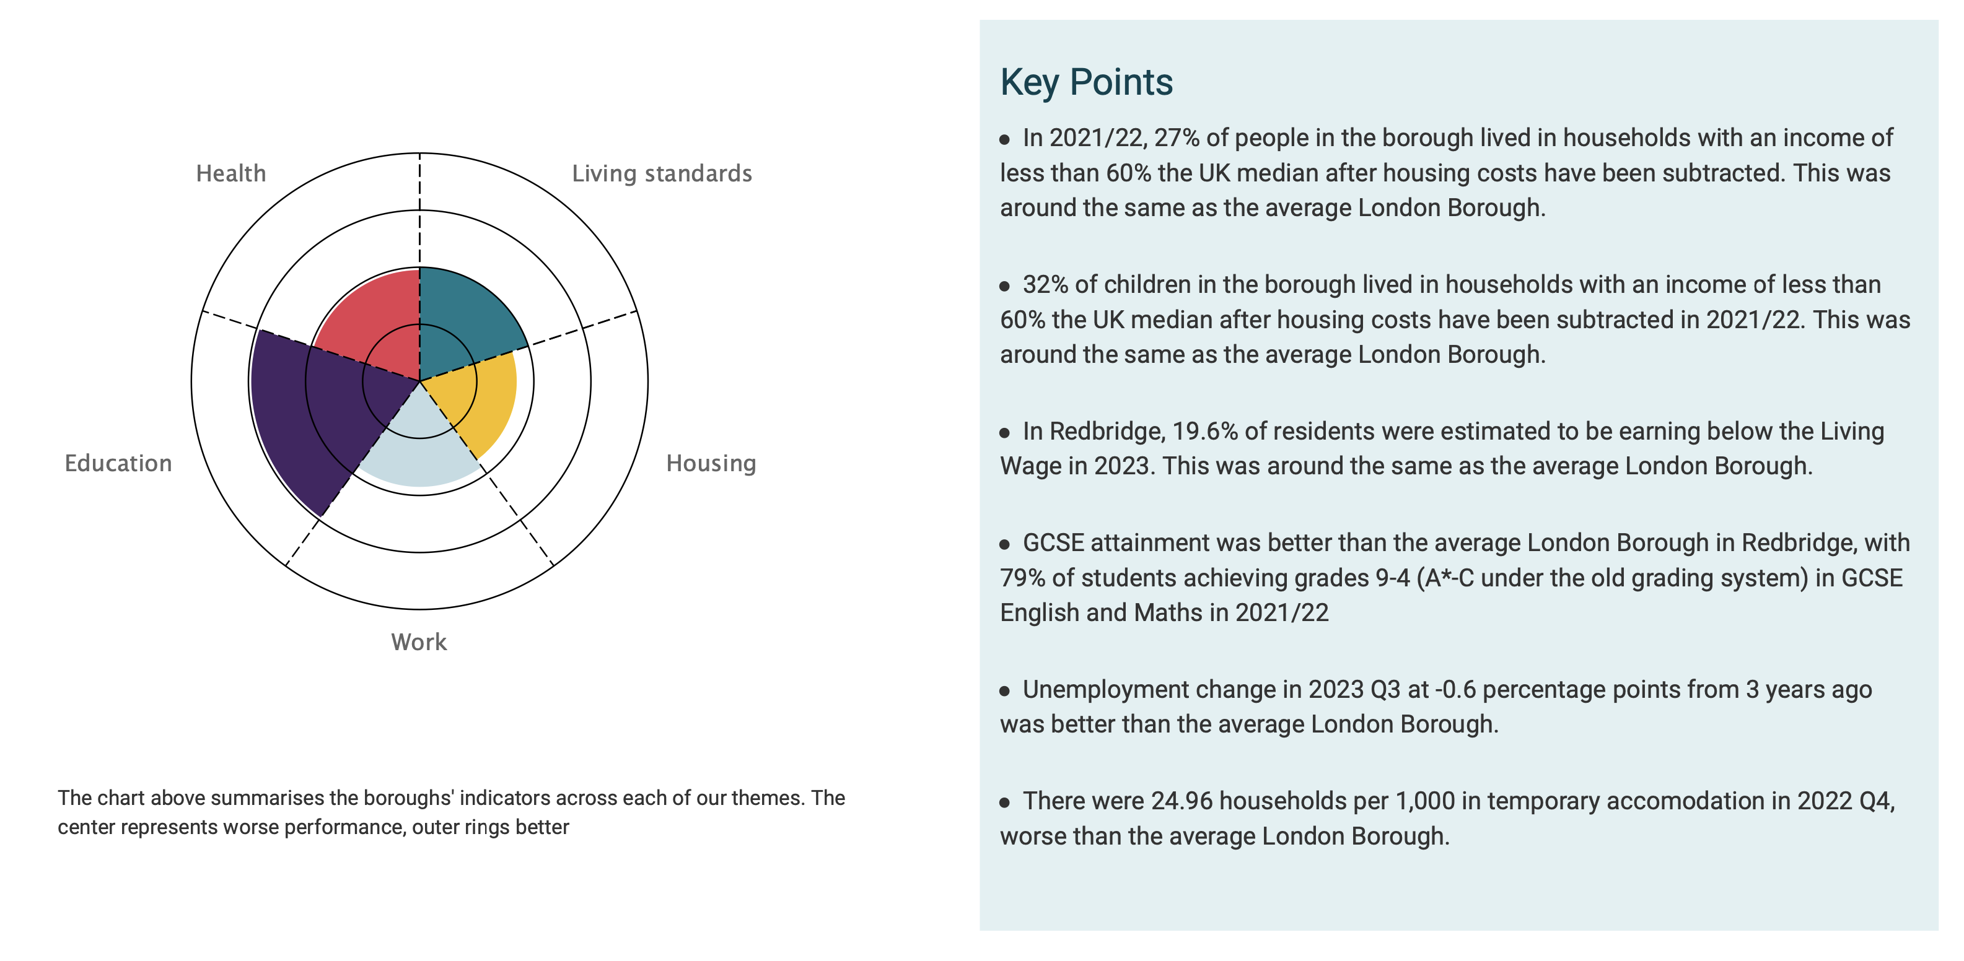
Redbridge Poverty

Slide 9
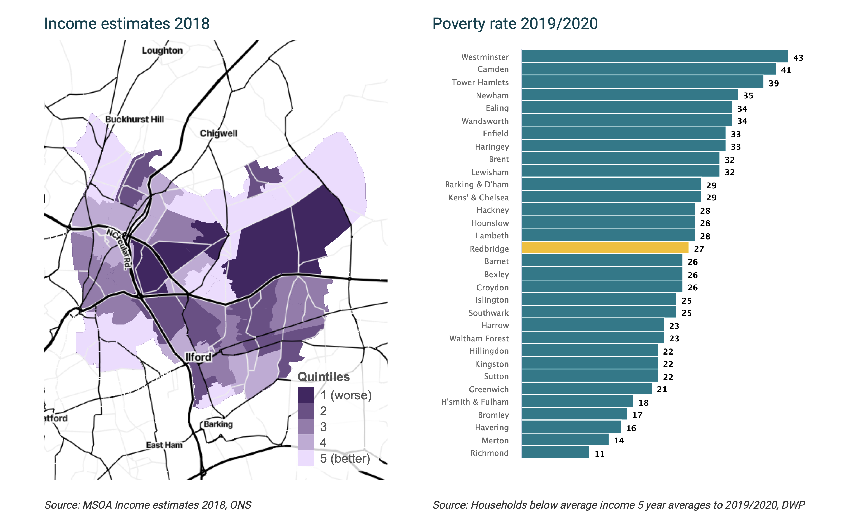

Slide 10
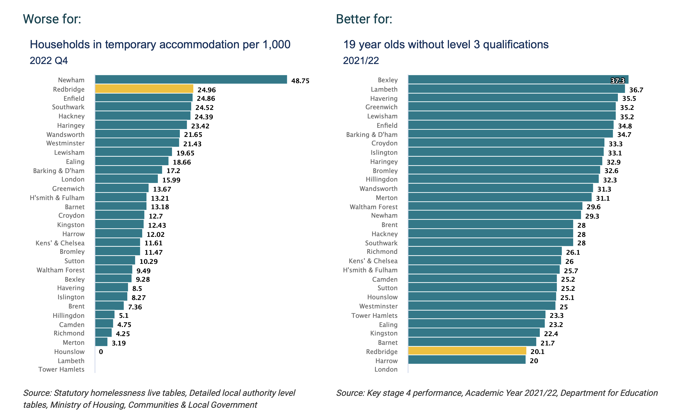

Slide 11
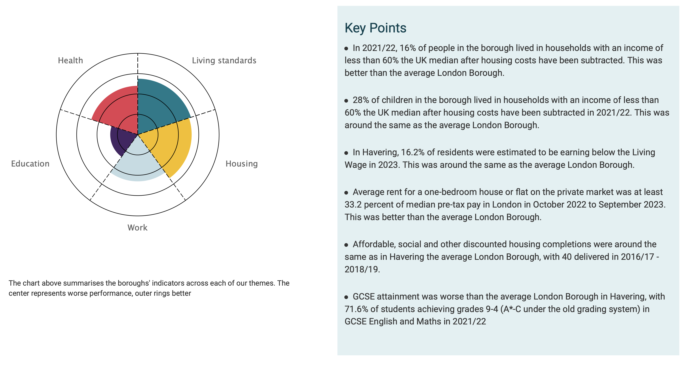
Havering Poverty

Slide 12
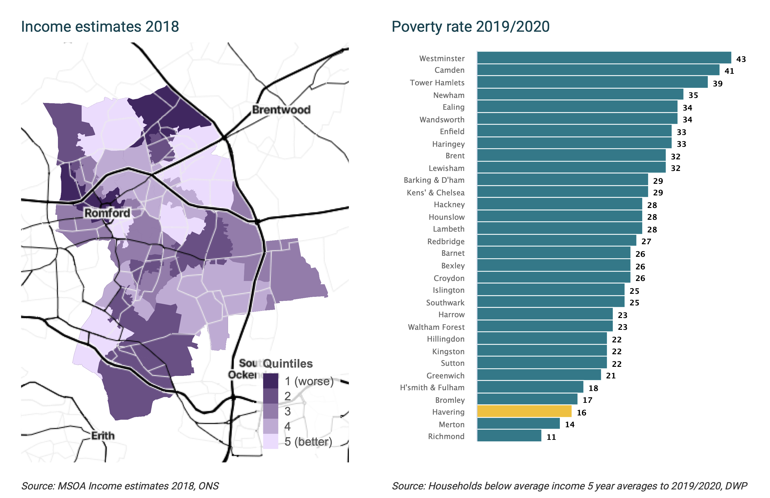

Slide 13
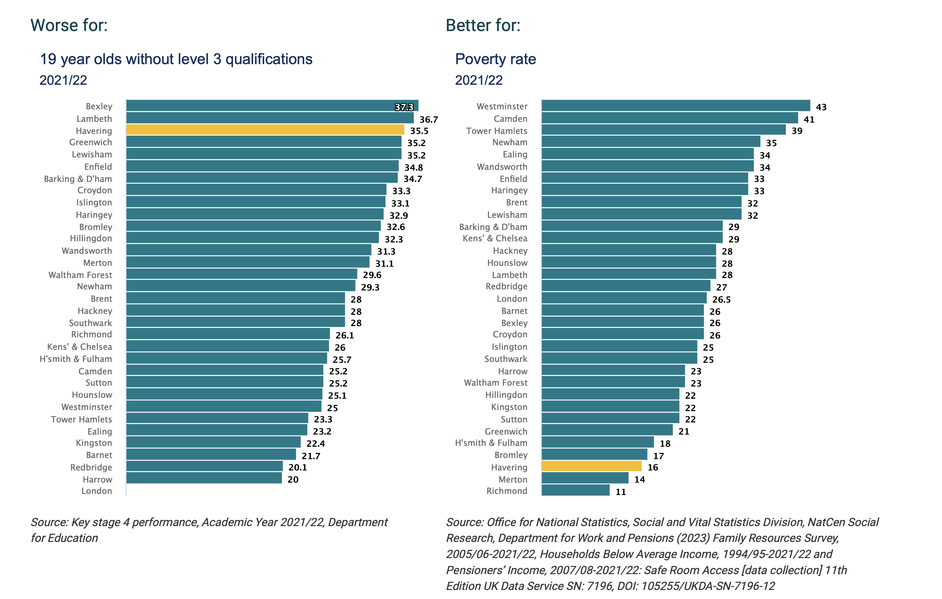

Slide 14
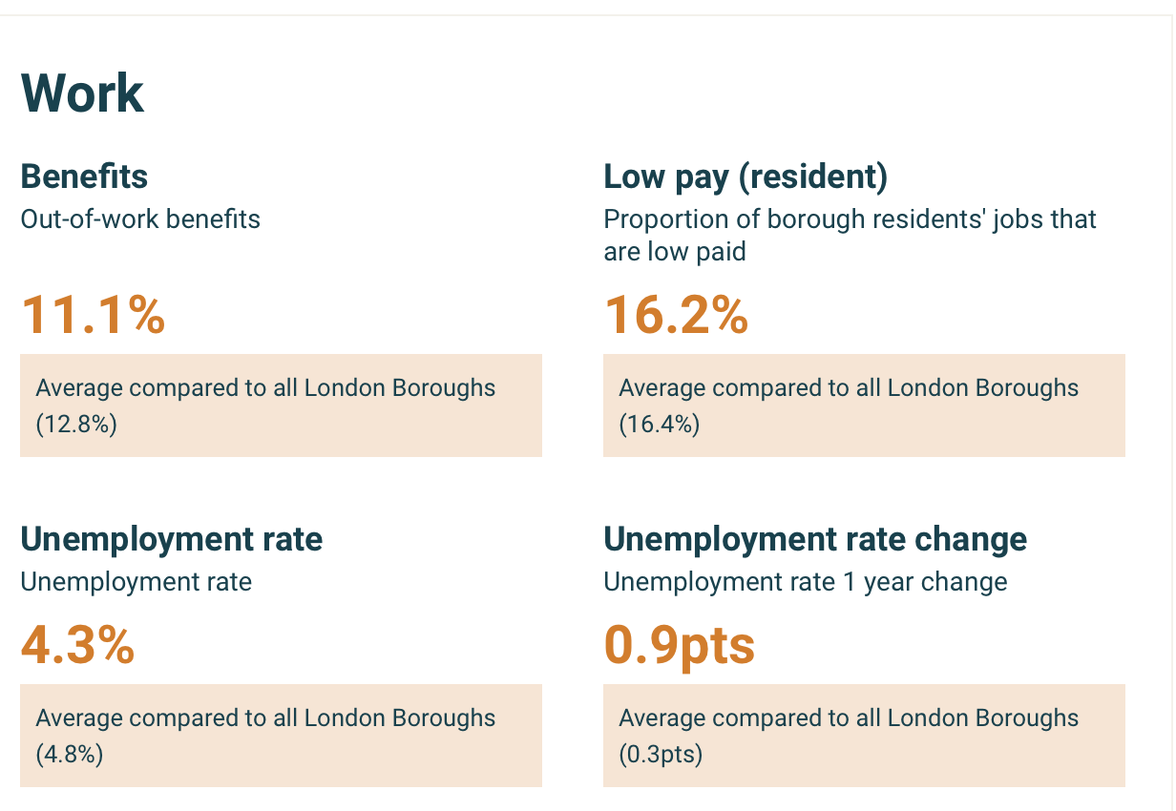
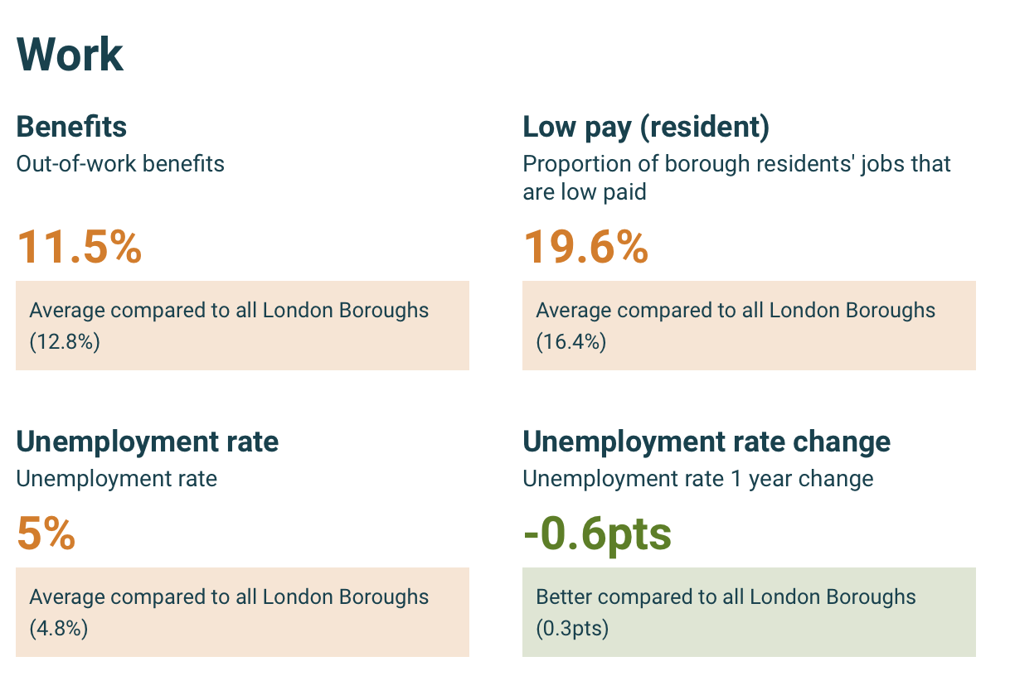
Havering & Redbridge Work Profile Census 2021
Havering
Redbridge

Slide 15
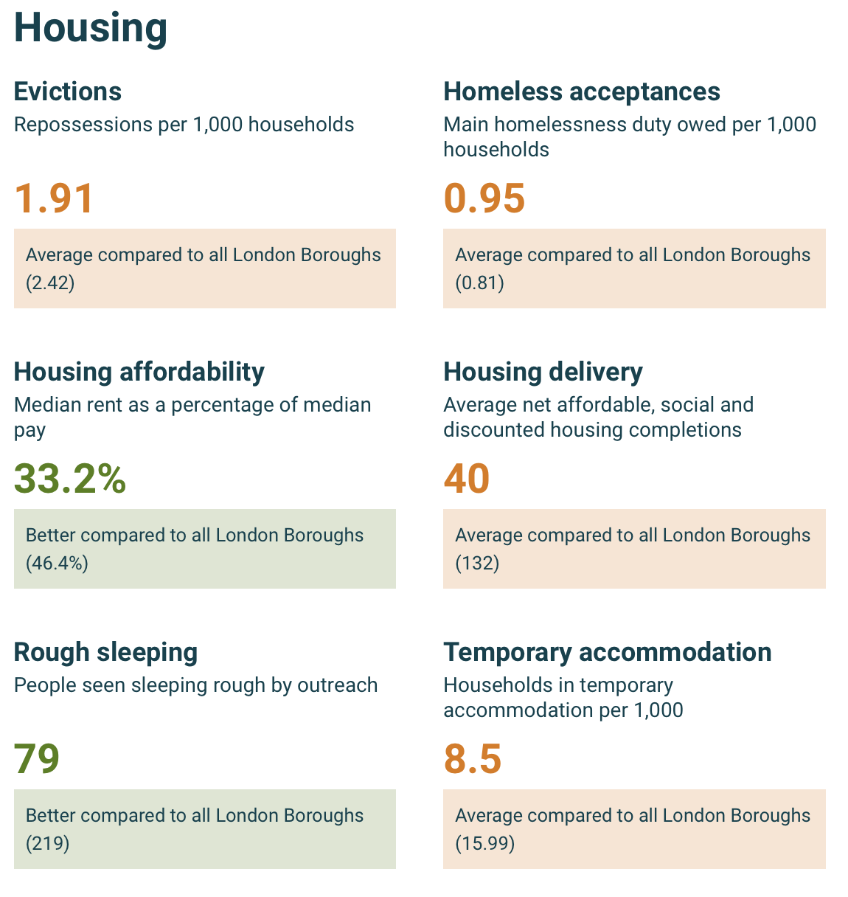
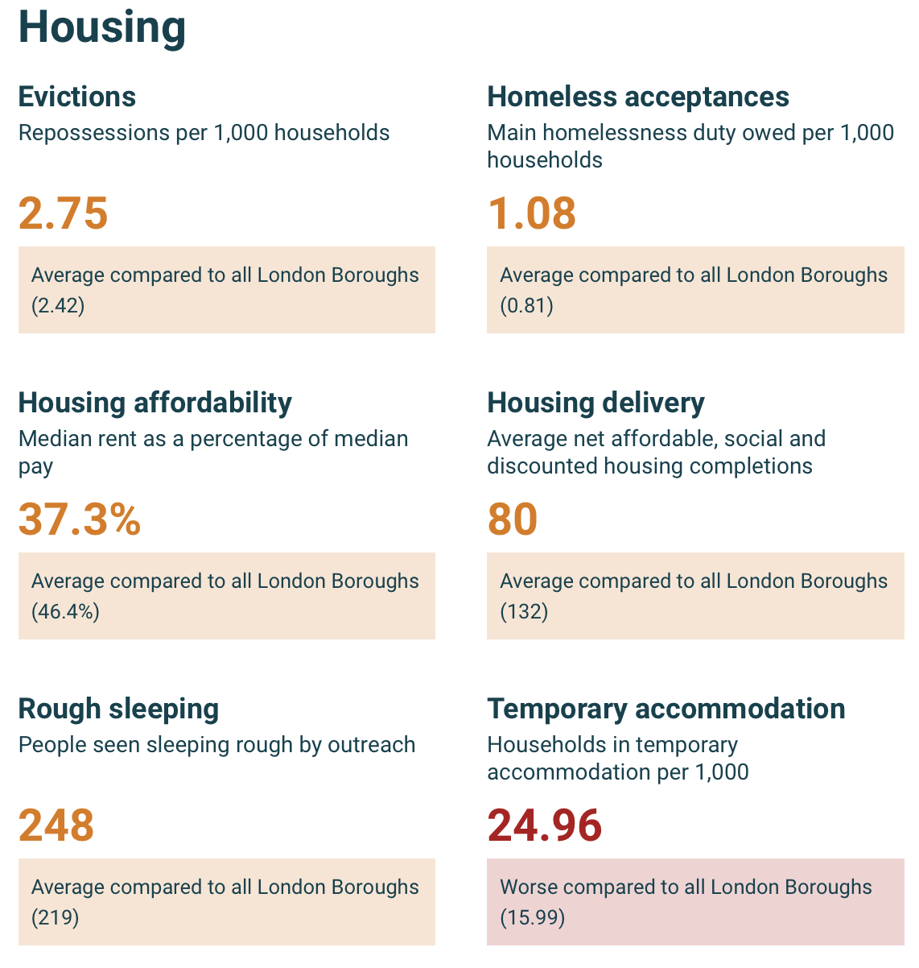
Havering & Redbridge Housing Profile Census 2021
Havering
Redbridge

Slide 16
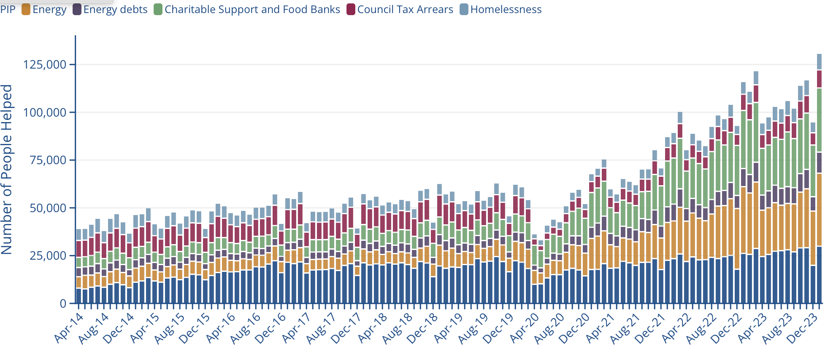
CA Trends of key cost-of-living issues since 2014

Slide 17
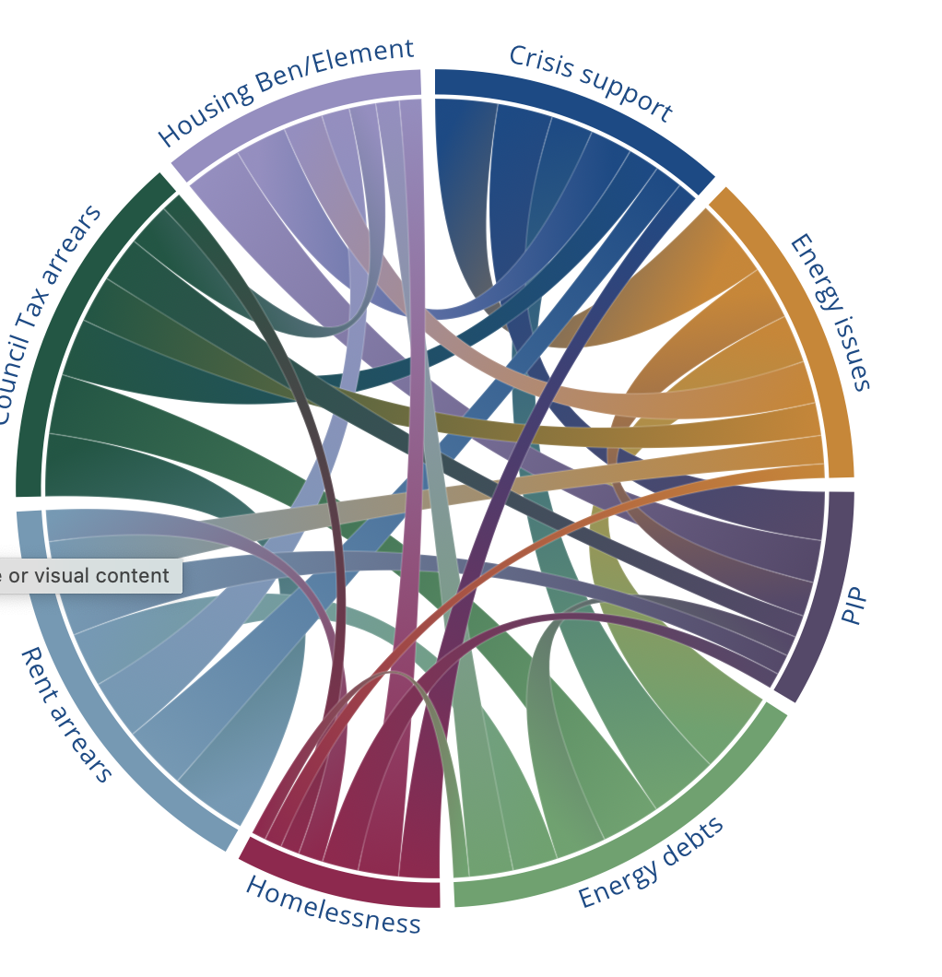
Problems are Complex
This chart shows how when we help people with one cost-of-living issue, we usually help them with another.
For example, of the people we helped with energy issues in 2023, over 50% needed help with crisis support (like food bank referrals or emergency charitable support). This shows that many people who need help with an energy issue are struggling to afford their essentials.

