Slide 1
London Citizens Advice: Working with London’s diverse communities to address cost of living. James Sandbach & Mary-Ann Foxwell
Collaborating across the Capital

Slide 2
Introduction
Citizens Advice in London are 28 separate local Citizens Advice (LCA), all are independent charities that are members of Citizens Advice and deliver a core information & advice service (benefits, debt, employment, housing, consumer)
Most London LCAs cover one borough, but some deliver over a wider footprint; annually the London Citizens Advice network delivers advice to over 250,000 Londoners through different channels
All London LCAs are supporting a pan-London development project, one of our objectives is to enhance engagement with London’s diverse communities.
Notes:
Although we are 28 separate charities, we are one service

Slide 3
The pan-London perspective
Our pan-London project aims to be transformative:-
London’s communities are as dispersed as they are diverse, borough boundaries are irrelevant to many community groups and needs
Opportunity to address uneven capacity (& funding) of LCAs across London; inner London LCAs have more resources than outer London, but advice needs are growing in outer London.
Big issues on the London policy agenda (regeneration, affordable housing, poverty, community cohesion); we have good data to share
www.londoncitizensadvice.org.uk
Notes:
London is one of the most diverse cities in the world. There are more than 300 languages spoken every day, 37% of the population were born outside the UK, multiple faiths, religions and are practiced – communities and faith groups no longer map onto boroughs. Our service aims to ne here for everyone.

Slide 4
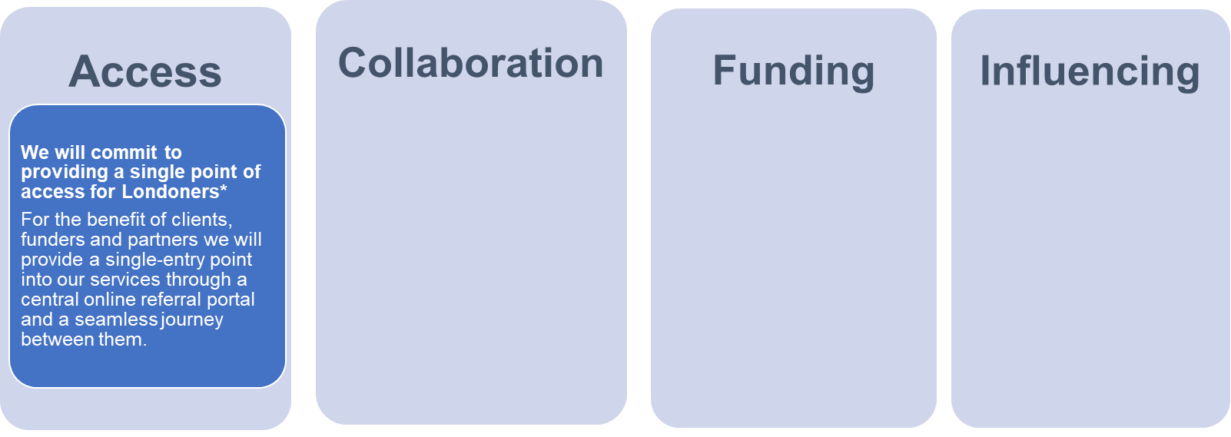
Pan London Compact: Vision & Commitments
Together we can be more than the sum of our parts. We are committed to working in a joined up way as one service, in partnership with others. We have a 3-year business plan underpinned by this compact.
We will commit to formalising ourselves as a new legal entity by signing-up to becoming a London Citizens Advice consortium.
We also commit to working with other advice sector partners on a pan-London level; developing our strategic partnerships in London.
We commit to becoming more ‘commission ready’ for pan-London funding opportunities, and building relationships with London funders.
This will require that we adapt to regional and sub-regional service boundaries.
We commit to pooling our data and insights to have an influential/ impactful policy voice for Londoners and for advice services.

Slide 5
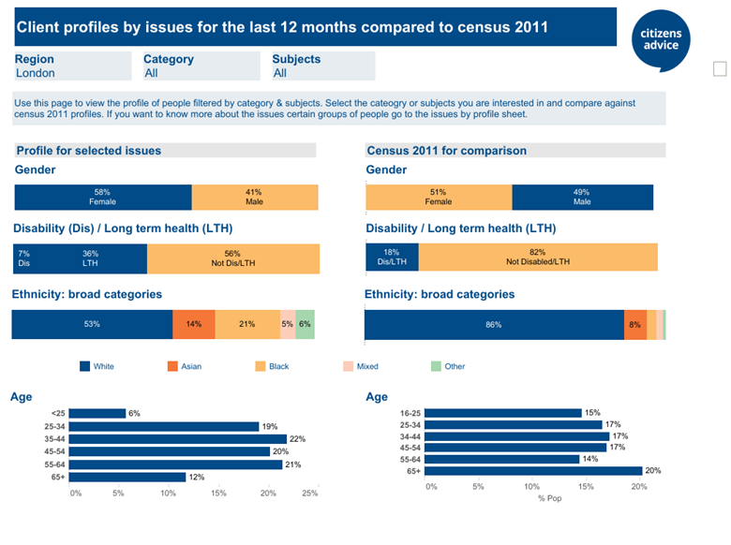
London LCAs have a diverse client base

Slide 6
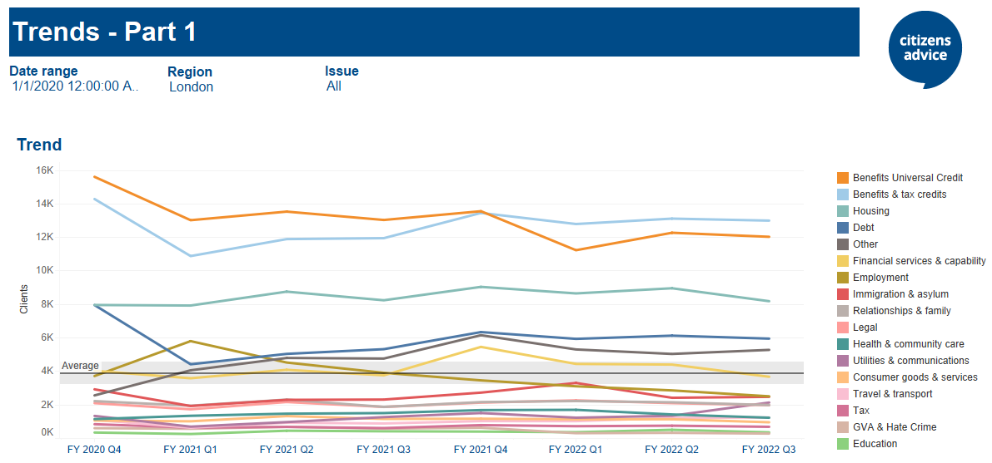
Overall Trends: 260,000 clients*
*172,000 counted through Casebook

Slide 7
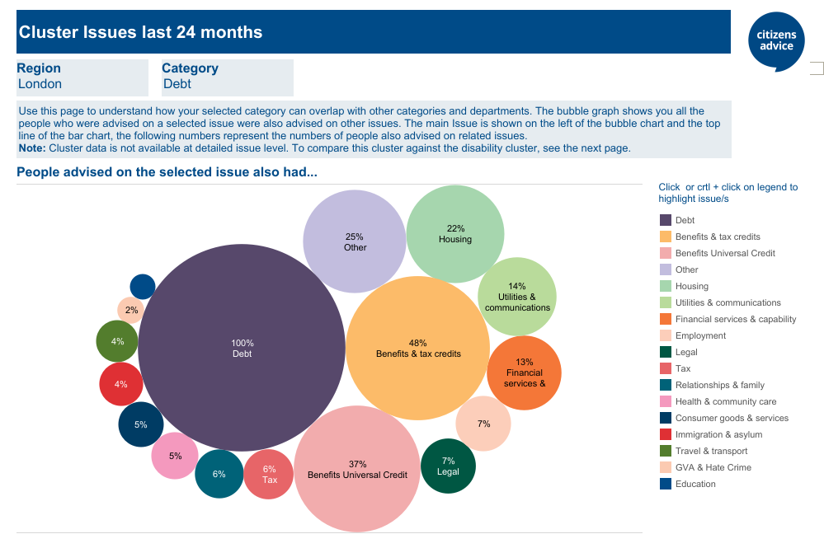
Problems - cluster

Slide 8
Some concerning trends….
Comparing London client stats 2020 and 2021:-
61% increase in number of clients looking to access localised welfare schemes, and a 46% increase in clients accessing charitable support
46% increase in Foodbank referrals/inquiries
43% increase in clients dealing with benefit deductions
Whilst only a 13% increase fuel debts, we saw an increase more general consumer utilities/essential services inquiries
Fuel (gas, electricity, oil, coal etc.) | + 60%
Water (suppliers, debt etc) | + 36%
Transport (public, motor costs etc) | + 34%

Slide 9
The worst is yet to come…
Our analysis of energy tariff data against historic benefits suggests that April’s estimated price cap rise will leave a single adult spending a third of their standard allowance - the basic rate of Universal Credit - on energy bills
Polling (from Opinium) this suggests 20% of Londoners are currently unable to afford energy bills, even if they cut back/fall behind on other essentials; this jumps to 33% people after the energy price cap 1st April, and only 8% think that the energy rebate will help them**
**10,301 UK adults aged 18+ between 8th to 17th February 2022 were surveyed.

Slide 10
Our approach to community engagement
There is no one size fits all model or approach, all communities are different
Local engagement often works best, LCAs have a range of outreach projects with local community groups, and deliver advice in different settings locally (foodbanks, day centres, places of worship, schools, libraries, community halls, GP surgeries/hospitals, courts, prisons, and local authority contact centres).
However, there is much we can do pan-London, especially a shared referral platform. All of our services use languageline.

Slide 11
Examples across London: West Central
Outreach Advice at Foodbank at the Notting Hill Methodist Church. GLA grant for community venues outreach advice, eg Bay 20 Community Centre
CAK & C Adult Social Care team have worked with community groups including Al-Hasaniya Moroccan Women Centre, Midaye Somali Development Network, Dadihiye Development Organisation, Ethiopian Women Empowerment Association in North Kensington, Women’s Association for Networking and Development (WAND UK) in North Kensington, and the Pepper Pot Day
Work with West London welcome which provides a wide range of support services to the large number of refugees and asylum seekers in West London, many of whom are housed in local hotels

Slide 12
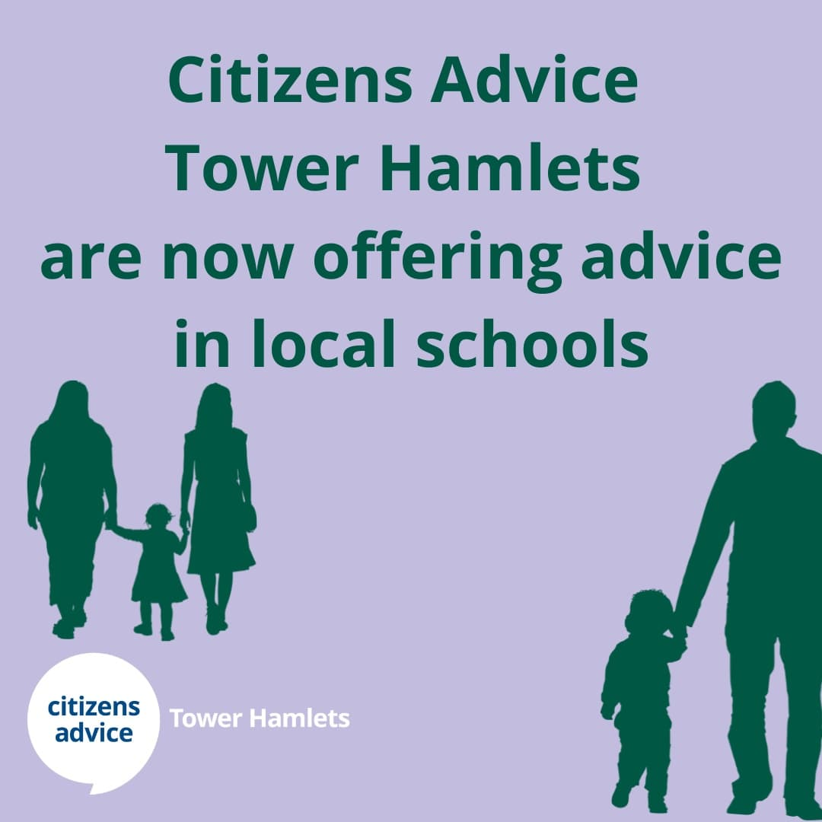
Examples across London: East
Huge range of initiatives including
Redbridge Community resilience network
Citizens Advice Barking and Dagenham leads partnership between the borough, the local VCS network and social sector, and food bank network
Across Hackney, Tower Hamlets, & Newham, advice services have been delivered through Children Centres, Local Authority offices, job Centres, GP Health Centres, hospitals, Housing Associations, social prescribers, estate-based community centres, and a variety of other unique locations – during lockdowns dedicated numbers were given to each user group, and new projects developed with schools

Slide 13
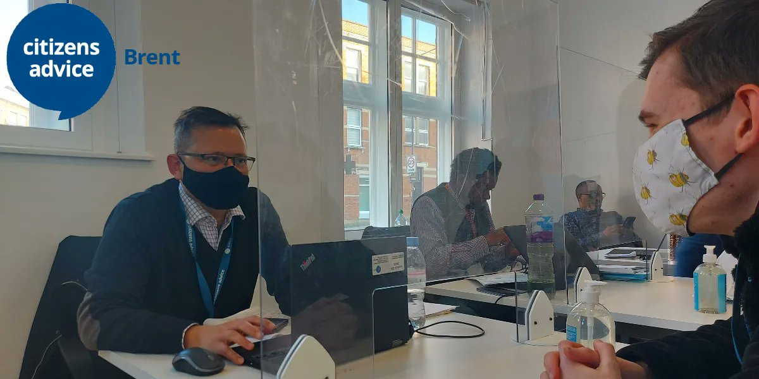
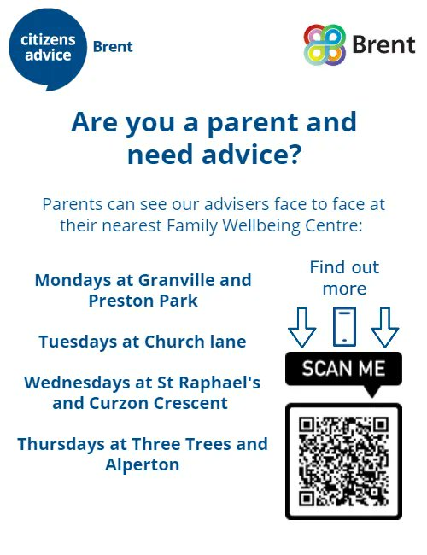
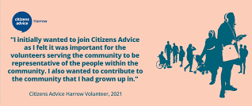
Examples across London: North
Brent Advice Partnership which is led by Citizens Advice in association with Advice4Renters, Age UK, Ashford Place and CVS Brent has over 70 members which reflect the borough’s diverse communities
The Haringey Advice Partnership (HAP) and partnership with Bridge Renewal Trust
CA Camden has delivered advice in different health settings
CA Harrow set up a Tamil Helpline
CA Waltham Forest works with 5 community
organisations to deliver social prescribing

Slide 14
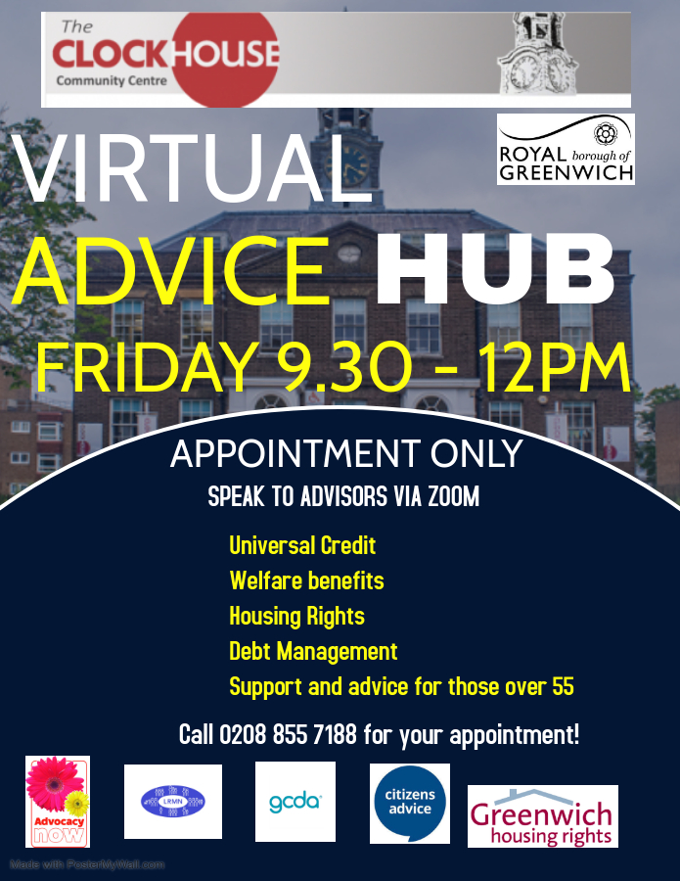
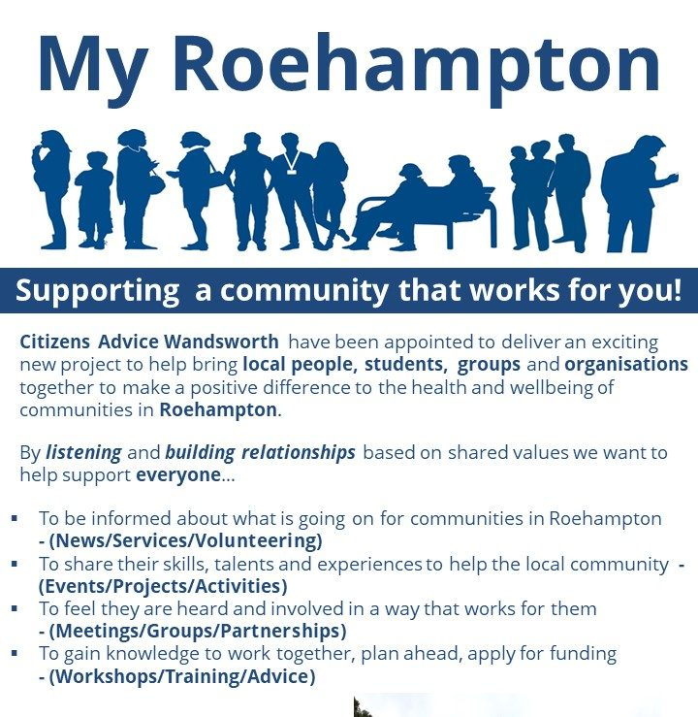
Examples across London: South
Citizens Advice Merton and Lambeth Living Well project in - assessors (information support and assessments) out and about in community venues
Citizens Advice Lewisham is lead agency for Advice Lewisham, includes 170 Community Project, a multi-lingual advice service (Tamil, Turkish, Arabic and Kurdish) & Refugee & Migrant Network
CA Southwark works with a ‘Universal Credit Network provides’ advice, support, information & training to local VCSOs that lack the capacity/expertise to assist their service users with UC issues
Bromley Well (Consortium)
Greenwich Seafarers’ Advice & Information Line (SAIL)

Slide 15
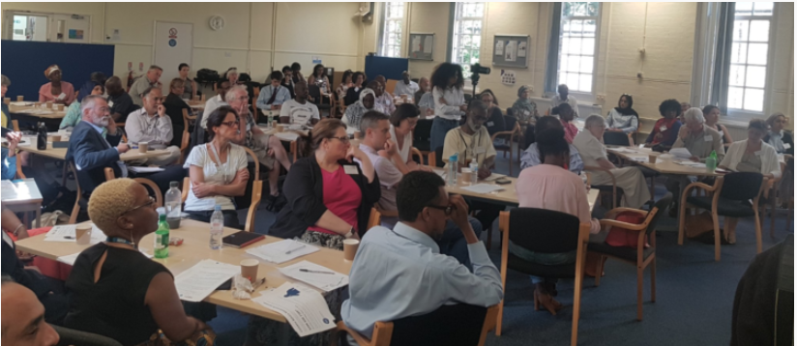
Citizens Advice Wandsworth (CAW) - investing in partnerships
Because:
We know that we can never meet the demand for our services.
We know that people in need of advice often don't come to advice agencies.
One of our organisational values is generosity
We know we don't have all the solutions; co-production is best.
Notes:
Approach to partnership work prompted by the organisational realisation that we can’t meet the demand for our services.
Underpinned by our commitment to ensure that although our services are for everyone – we want to be here the most for people who need us the most.
This realisation led to us putting equal emphasis on preventative work, and on collaboration; began speaking to community and faith groups in our borough.
Through these conversations we learnt the uncomfortable truth that we were viewed with suspicion by many in our community. And that people in need of advice often didn’t come to advice centres. Instead, they sought help from trusted people from within their communities. This might be their neighbor, their vicar, their Imam, or their boxing coach.
Equipped with the understanding that we couldn’t do this alone, we talked to community and faith groups across our borough about how we could together address local Hardship and Crisis.
We co-produced a model rooted in local-relationships and network development.

Slide 16
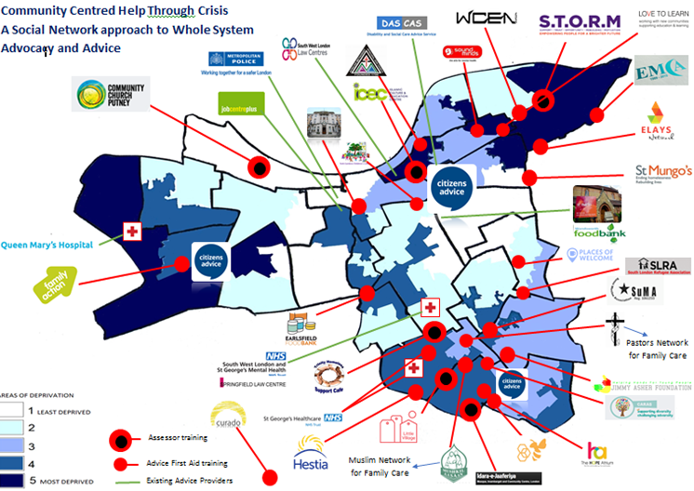
What we've done
Starting with individual relationships, we have built a network.
The network is made up of faith, community, voluntary and statutory partners.
We've shared our knowledge and experience, and have connected the network.
Notes:
This map shows some [by no means all] of the groups, or partners, in our network.
I’m not sure if you can see the listed partners – but it includes voluntary sector groups, faith and community groups as well as our statutory sector colleagues. The network is growing all the time
In this model we:
share our advice knowledge – enabling partners to spot advice issues, provide early information and signposting,
Provide a trusted referral route into our services, and
We connect the groups that come into contact with people experiencing hardship. with ourselves and each other.
Our statutory sector colleagues – from the local authority and the CCG – value the connectedness that we have, as well as the approach. As the work has progressed so they have become part of our network – for example every Wandsworth social prescribing link worker is part of our referral network.

Slide 17
How we've done it
We deliver Advice First Aid training.
We host network events and annual conferences; supporting the network, listening to concerns, and connecting people (including clients) with policy makers.
We connect our partners with us, and with each other, through hosting an online referral platform (Refernet)
We start by saying ‘we’d like to get to know you’ and then really getting to know them, ideally by spending time with them. And only then do we introduce who we are and how we think we may work together.
We don’t and shouldn’t try to shape the other organisation’s way of working to fit our own systems and processes.
Notes:
We keep high-level investment in the project - The work is overseen by a steering group with representation across the sectors – that includes senior stat sector colleagues [particularly with an eye to the sustainability of the work]
Advice First Aid training is the main way in which we share our advice knowledge with our partners.
We also bring network members together at regular events and annual conferences. The topics covered are informed by the interests of our community partners – but tend to be led by our understanding of need. E.g. UC, Housing, Covid changes (furlough etc.)
We connect our network partners with us, and with each other through these events, as well as through the hosting of an online referral platform.
This platform links voluntary, statutory, community and faith partners together – it links us and reduces the risks of people falling between the cracks in services.
Disclaimer: Although Citizens Advice Wandsworth trains volunteers to identify local residents in need of advice and support, find useful information, and refer residents to local services which can assist with help, support or advice, no liability attaches to Citizens Advice for any assistance or service offered by other organisations.

Slide 18
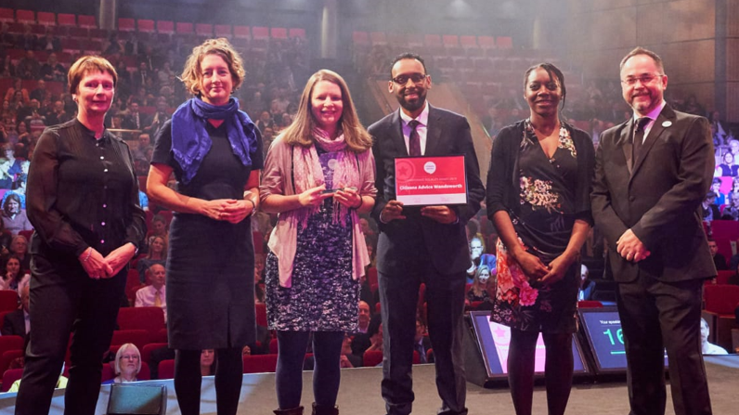
What we've gained
Reach
Reputation
Funding
More insight
Greater influence
More security; making ourselves indispensable
A more diverse staff and volunteer team
Notes:
Trust in us, and connections to us, have grown – and as a result we have increased our reach.
We really felt the benefit of this during the pandemic shut-down period when our partners kept referring people – who we know wouldn’t have been able to navigate our telephone or online platforms.
We have a great reputation. The picture shows us winning an award at the last in-person CA conference in Manchester. The man holding the red certificate is Abudirahman; one of our community partners. -- Ongoing engagement in our work from community leaders like Abdirahman is vital to us maintaining our local reputation.
We listen to the issues our partners, like Abdurahiman, want us to address. Last month we ran a network event on school exclusions – with a particular focus on the disproportionate number of black children and young people impacted. It’s not an area we advise on – but we facilitated the session – because this is what our partners told us they needed.
Our advocacy work, and our funding strategy, is informed by this insight we gain from our connectedness with our partners – this connectedness gives us legitimacy (as well as responsibility).
With greater insight and trust has come better recruitment. Our team now better reflects our community in every way, which pays so many dividends.

Slide 19
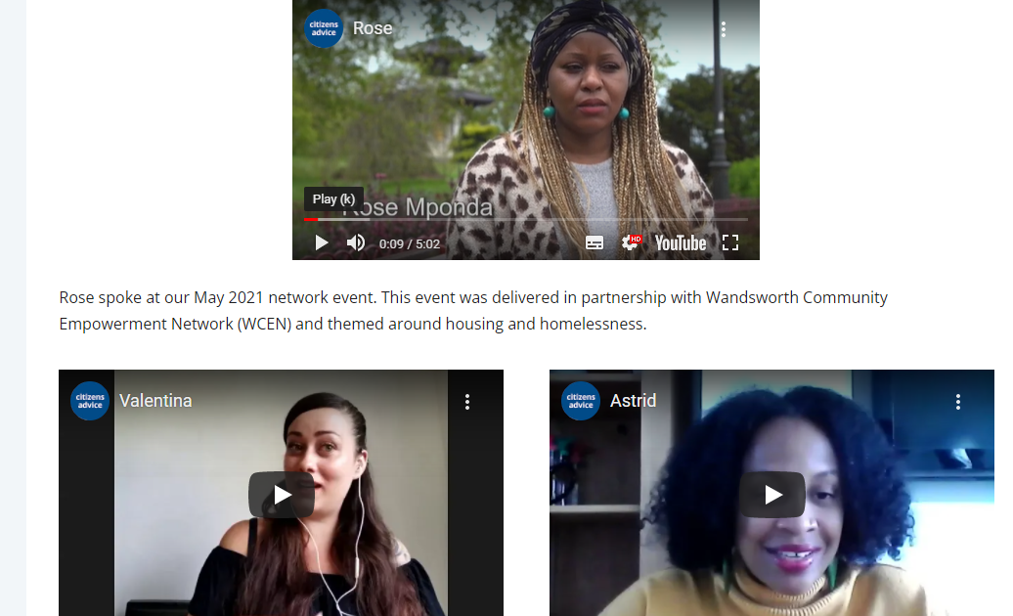
What we've learnt
'A true partnership doesn’t start with an agenda, and doesn’t start with us going to another organisation and saying ‘we have this idea, and we want to work on it together’.
To forge a true partnership, we should start with asking questions and seeking to understand the other organisation'.
Forget emails
Food is good
'show-up'
Be flexible; listen and respond
Trusted intermediaries are valuable
It's worth it; the investment pays
dividends in so many ways.
Notes:
We endeavour to involve clients in our partnership approach. We ensure their voices are heard - the image on this slide is of three clients who have told their stories at recent online network sessions.
Client stories are reliably the most impactful part of our events.
They talk about their experiences of hardship to an audience which includes the partners whose services might, or might not, have tried to support them, and the policy makers whose departments have too often let them down.
Of course, we too are service providers, and as such listen to our clients as we do our other partners - in order to make our services better.

Slide 20
What we’re now seeing at CAW….
Notes:
Will finish by giving you a more quantitative picture of the experiences of our clients.
Since the beginning of the pandemic we’ve been tracking the hardship experienced by the people who seek advice from us. We use foodbank referral, charity application, discretionary social fund applications and fuel-related debts as proxies. The graph shows the concerning increase in clients presenting to us in severe hardship.

Slide 21
In conclusion – London Citizens Advice
Embedded in local communities with many different models of outreach and engagement
Already seeing increase in hardship and impact from cost of living crisis
LCAs were helped through Covid & pivoting to remote advice through emergency funding – but with many services being re-commissioned scaling up and sustaining services is challenging
Partnership with community & faith groups will be key

