Slide 1
London Citizens Advice: Pan-London working James Sandbach & Mary-Ann Foxwell
Collaborating across the Capital

Slide 2
What we’re now seeing at CAW….
Notes:
Will finish by giving you a more quantitative picture of the experiences of our clients.
Since the beginning of the pandemic we’ve been tracking the hardship experienced by the people who seek advice from us. We use foodbank referral, charity application, discretionary social fund applications and fuel-related debts as proxies. The graph shows the concerning increase in clients presenting to us in severe hardship.

Slide 3
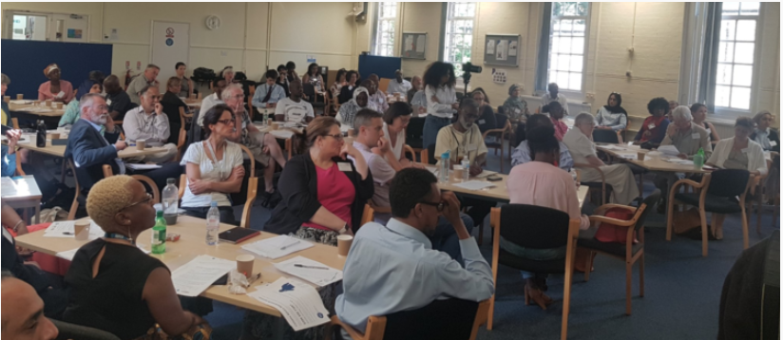
Background: Citizens Advice Wandsworth (CAW) - investing in partnerships
Because:
We know that we can never meet the demand for our services.
We know that people in need of advice often don't come to advice agencies.
That too often people fall through the gaps in services
We know we don't have all the solutions; co-production is best.
Notes:
Approach to partnership work prompted by the organisational realisation that we can’t meet the demand for our services.
Underpinned by our commitment to ensure that although our services are for everyone – we want to be here the most for people who need us the most.
This realisation led to us putting equal emphasis on preventative work, and on collaboration; began speaking to community and faith groups in our borough.
Through these conversations we learnt the uncomfortable truth that we were viewed with suspicion by many in our community. And that people in need of advice often didn’t come to advice centres. Instead, they sought help from trusted people from within their communities. This might be their neighbor, their vicar, their Imam, or their boxing coach.
Equipped with the understanding that we couldn’t do this alone, we talked to community and faith groups across our borough about how we could together address local Hardship and Crisis.
We co-produced a model rooted in local-relationships and network development.

Slide 4
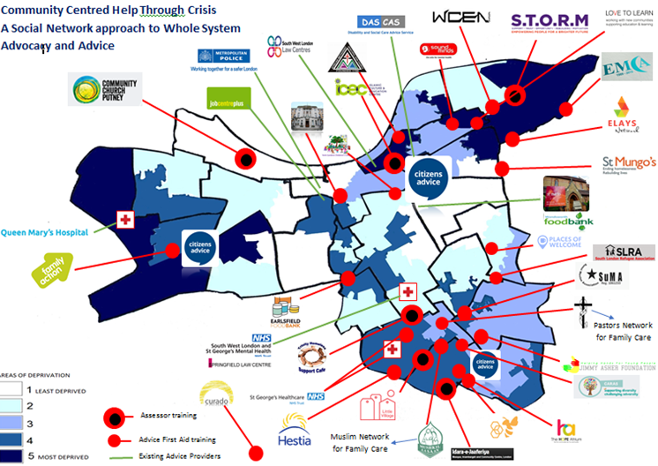
Background: a local network
Starting with individual relationships, we have built a network.
The network is made up of faith, community, voluntary and statutory organisations.
It includes advice sector partners.
We've shared our knowledge and experience and have connected the network.
Notes:
This map shows some [by no means all] of the groups, or partners, in our network.
I’m not sure if you can see the listed partners – but it includes voluntary sector groups, faith and community groups as well as our statutory sector colleagues. The network is growing all the time
As I said, we started with the relationships, together we generated ideas and an approach, and then got funding.
Initially [in 2016] this funding was from the Big Lottery for a model with network [or, partnership] development at its core.
In this model we:
share our advice knowledge – enabling partners to spot advice issues, provide early information and signposting,
Provide a trusted referral route into our services, and
We connect the groups that come into contact with people experiencing hardship. with ourselves and each other.
Subsequently, we have built this approach into all our funding and delivery proposals – with good success.
Our statutory sector colleagues – from the local authority and the CCG – value the connectedness that we have, as well as the approach. As the work has progressed so they have become part of our network - and indeed they now fund us on the basis of our approach.

Slide 5
London Local Citizens Advice
Citizens Advice in London are 28 separate local Citizens Advice (LCA), all are independent charities that are members of Citizens Advice
Most London LCAs cover one borough, some deliver over a wider footprint; annually the London Citizens Advice network delivers advice to over 250,000 Londoners through different channels
CEOs forum met quarterly, lacked capacity to engage strategically on London agenda. But identified a need..

Slide 6
Pan-London: Background
In 2019 a consultant was engaged with brief to look at how Pan-London working could be enhanced:-
To ensure the London Citizens Advice voice is heard and has a seat at the table for Pan-London policy and service discussions
To work with policy-makers, commissioners and key funders on London-wide developments, including research and campaigns at Pan-London level
To respond to and apply for Pan-London advice funding opportunities
To facilitate potential Pan-London business development and joint working (potentially including recruitment, training and HR support)
In 2021 London CEOs decided to club together to support a London Development post, hosted/employed by RCJ Advice on behalf of the London LCA network.
A steering group of 8 CEOs provide the governance for the pan-London project

Slide 7
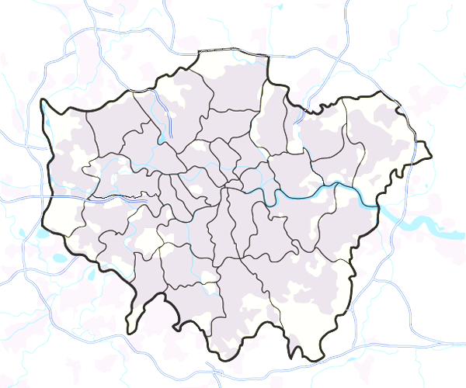
Why Pan-London?
Uneven funding of LCAs and other advice services across London; inner London LCAs attract more funding than outer London LCAs, however advice needs are growing in outer London (see ASA report)
London’s communities & needs are as dispersed as they are diverse
Many commissioners procure services over multi-borough footprints whilst boroughs’ funding environment becoming more challenging
There are big issues on the London policy agenda (regeneration, affordable housing, community cohesion); we have good data to share on trends and needs across London.

Slide 8
First steps
Consultant’s report recommended new staff capacity and structure
London Development Manager
(single point of contact for stakeholders)
Hosted with RCJ Advice team
Steering Group
(Reports to CEO Forum)
Representative of full spectrum of LCAs
Terms of Reference for Steering Group
Oversight of Business Plan
Position London Citizen Advice services effectively in the external environment
Identify & realise opportunities for development of Pan or sub-regional London new services and projects
Review at 12 Months
Develop new governance structure (consortium)
Consolidate London projects in new structure
Develop and implement a funding strategy to access a diverse range of pan-London or sub-London income streams
Ensure London Citizens Advice network is visible in key policy and services debates

Slide 9
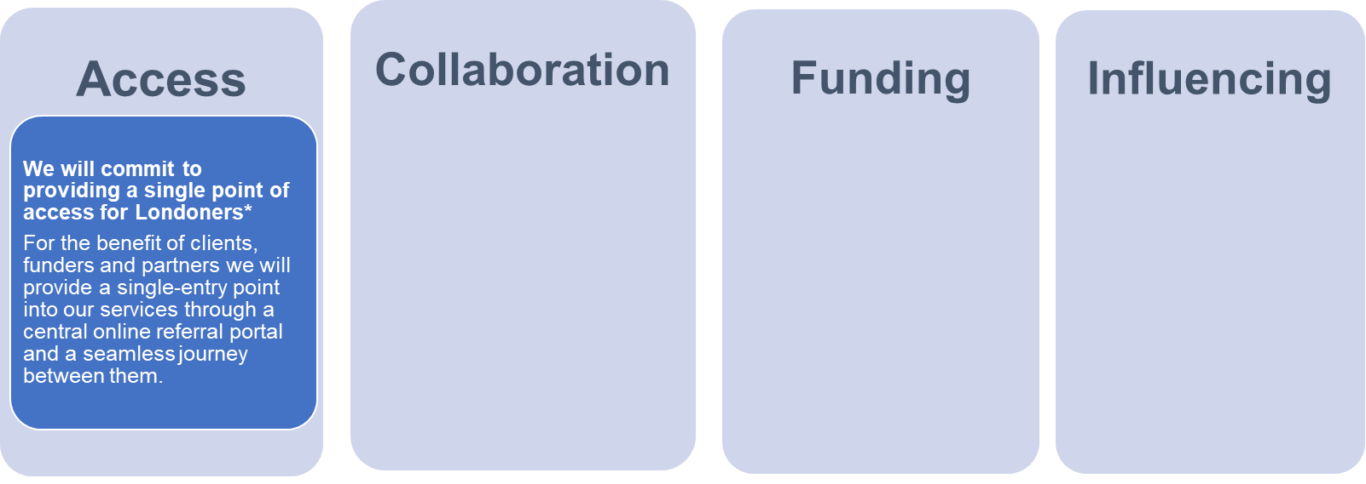
Pan London Compact: Vision & Commitments
Together we can be more than the sum of our parts. We are committed to working in a joined up way as one service, in partnership with others.
We will commit to formalising ourselves as a new legal entity by signing-up to becoming a London Citizens Advice consortium.
We also commit to working with other advice sector partners on a pan-London level; developing our strategic partnerships in London.
We commit to becoming more ‘commission ready’ for pan-London funding opportunities, and building relationships with London funders.
This will require that we adapt to regional and sub-regional service boundaries.
We commit to pooling our data and insights to have an influential/ impactful policy voice for Londoners and for advice services.

Slide 10
Objectives and priorities
Key/immediate priorities are:
Building relationship with GLA (and its stakeholders), Mayor’s office, MOPAC etc – London recovery and safety net agenda
Launch new website www.londoncitizensadvice.org.uk
Develop London Adviceline group, and an online single point of access
‘Onboarding’ with Prison and Probation service
Briefings for London elections
Share and develop community engagement (especially with newly arrived communities)
Be an influential and impactful policy voice for Londoners and for advice services in London, drawing on our data and insights, and engaging with London stakeholders | Become ‘commission ready’ for pan-London funding opportunities, and building relationships with London funders | Collaborate across London LCAs to develop a pan-London structure, and encourage partnership working across London’s advice sector | Provide for the benefit of London clients, funders and partners, a single-entry point into our services, and a seamless user journey

Slide 11
London data: 260,000 clients (2021)*
*172,000 counted through Casebook

Slide 12
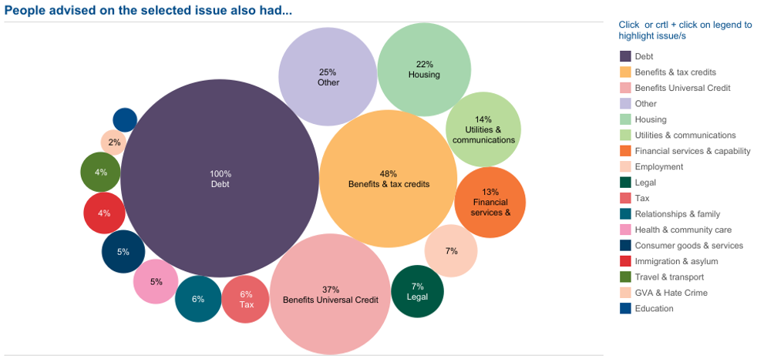
Problems – cluster (debt)

Slide 13
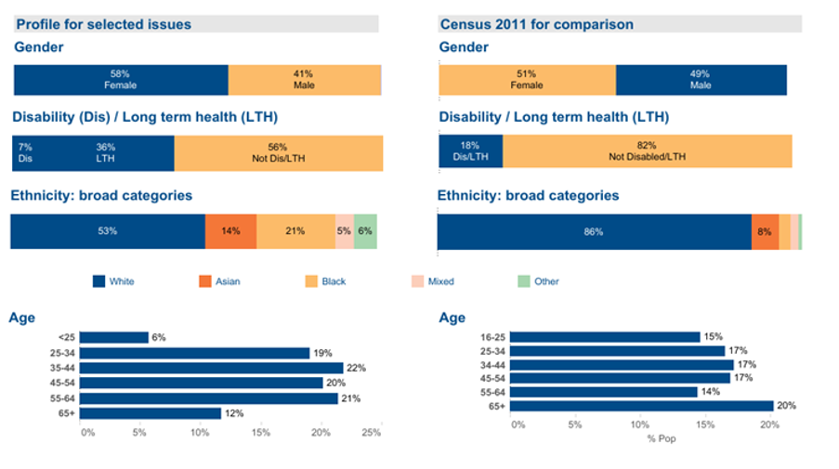
Client demographics

Slide 14
Some concerning trends….
Comparing London client stats 2020 and 2021:-
61% increase in number of clients looking to access localised welfare schemes, and a 46% increase in clients accessing charitable support
46% increase in Foodbank referrals/inquiries
43% increase in clients dealing with benefit deductions
Whilst only a 13% increase fuel debts, we saw an increase in more general consumer utilities/essential services inquiries
Fuel (gas, electricity, oil, coal etc.) | + 60%
Water (suppliers, debt etc) | + 36%
Transport (public, motor costs etc) | + 34%

Slide 15
London challenges: Cost of living, Covid recovery, and new migrant communities
To respond we must reach out to/work with diverse communities
No one approach fits all
Local engagement often works best, LCAs have a range of outreach projects with local community groups, and deliver advice in different settings locally (foodbanks, day centres, places of worship, schools, libraries, community halls, GP surgeries/hospitals, courts, prisons, and local authority contact centres)
However, there is much we can do pan-London, especially a shared referral platform and developing London Adviceline. All of our services use languageline.

Slide 16
In conclusion
We want to give London-wide funders a service for Londoners that they can invest in, increasing opportunities for partnerships, improving access and outcomes for clients
Contact:
james.sandbach@rcjadvice.org.uk
mary-ann.foxwell@cawandsworth.org

